Slide 1
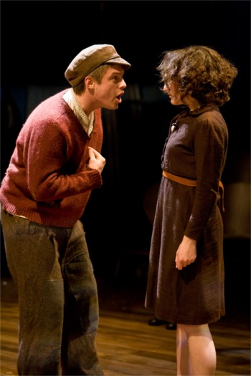
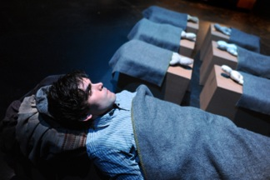
Character
Dr Korczak was a real person whose life story and beliefs are well documented.
Adzio and Stephanie represent orphans.
Cerniakov symbolise the people who tried to help Dr Korczak.
The unseen soldier is a constant reminder of the Jews’ incarceration within the ghetto.
Greig chose to use dolls to represent the orphans and some of the other characters. He said this was because a large cast was not suitable for the original schools’ tour.
The dolls also encourage the audience to visualise the personalities of the dolls, thus engaging them in the issues

Slide 2
Character
Here are some key characters with some key words
Characters | Description
Dr Korczak | Idealistic, compassionate, gentle
Adzio | Wild, troubled, aggressive
Stephanie | Loyal, responsible, kind
Stepan | Realistic, generous, honest
Cerniakov | Honourable, pragmatic, conscientious
The Priest | Hypocritical, bigoted, weak
The Nazi Officer | Merciless, cruel, brainwashed

Slide 3
Character
Look at the mind map of Stephanie. Find three quotes to support the descriptions:
Loyal
Sc 2 Stephanie repeats “He believes” – loyal to Dr K
Sc19 She apologies because she let down Dr K
Stephanie
Kind
Sc7 Asks Dr K what is worrying him
Sc13 Sits with Adzio and tries to find out why he is upset
Responsible
Complete similar mind maps for the characters in the previous table.
Sc 11 Speaks up for Adzio in court despite disliking him
Sc2 In charge of taking details of new orphans
Sc15 the “older boys” give her the note to take to Dr K about

