Slide 1
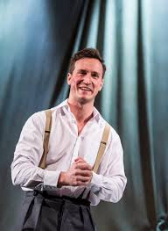
“The Woman in Black” Character Revision
Max Hutchinson – “The Actor”
Max Hutchinson – “Mr Kipps”
Contrast
The performance starts with Max Hutchinson playing, “The Actor” a man employed to help Mr Kipps bring his story to life. “The Actor” then goes on to a play a young version of Mr Kipps.
Throughout most of the performance, “The Actor” then plays the young “Mr Kipps”. He wears a tie and suit to show that he is now “Mr Kipps”.
Characterisation on “The Actor”
He is a very confident character with a booming voice that projects from the back of the stalls and a confident stance with his head held high and shoulders back. He smiles showing a calm nature as a character. The pace of his voice is quite fast to show he is confident and excitable. This clearly shows he is an actor and that the character has not been affected by the story of the woman in black.
Characterisation of “Mr Kipps”
As a young Mr Kipps, he is enthusiastic, with a smiling face and a vigourous handshake. His tone is calm and pleasant to begin with.
After seeing the Woman in Black he starts to show more tension in the way he stands. He walks slower, has his shoulders raised more with clenched fists. His voice is more hesitant and quiter to show the impact that this event has had on him.

Slide 2
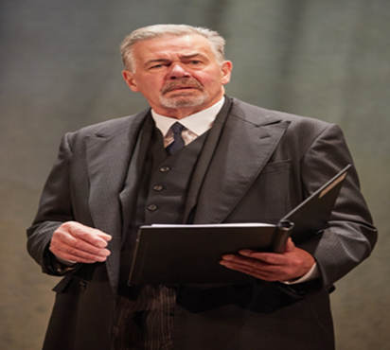
Terence Wilton - Mr Kipps
Mr Kipps as Mr Bentley
The actor playing Mr Kipps will take on multiple roles throughout the play. But we need to remember that Mr Kipps, the character, is playing all the other roles
Mr Kipps plays the role of Mr Bentley, Mr Kipps boss. To play the role he wears a pair of glasses to transform into this character.
Characterisation on “Mr Bentley”
The actor is very hesitant to begin with when playing this role. This is to show that the character of Mr Kipps is struggling to get into role and is uncomfortable with acting, which he says at the beginning of the play. As the scene carries on he becomes more confident as we see him change his volume to be louder when talking to show a confident and powerful character.
Characterisation on “Mr Kipps”
We first meet Mr Kipps when he is reading his encounter with the Woman in Black.
He is a hesitant man, who talks slowly and quietly to portray a deeply insecure and frightened person. He has a tense posture and looks very awkward to highlight to the audience that he has been deeply affected by the experiences with the Woman in Black.

Slide 3
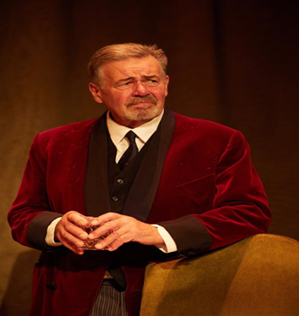
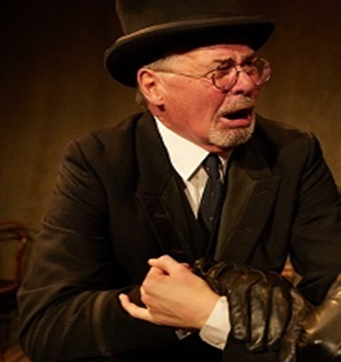
Mr Kipps as Sam Daly
Mr Kipps as Jerome
Mr Kipps is now more comfortable with playing characters and now plays the role of Sam Daly, a successful business man who lives in Cryfin Gifford where Jennet, the Woman in Black, lived.
Jerome is a local agent that has dealing with Alice Drablow that lived at Eel Marsh House. He saw the Woman in Black and lost a child.
Characterisation of “Jerome”
Jerome is played as a very nervous man. He plays around with his hat a lot to show that he is a nervous man. When we first meet him he is very quiet, which reinforces a scared or nervous person. He is played with an extremely high energy went the Woman in Black is mentioned. He starts to scream, his voice becomes louder, his movements are quicker. This is done to clearly show what the impact of seeing the Woman in Black can do.
Characterisation of “Sam Daly”
The accent has now changed. Sam Daly has a northern accent. This shows the audience that we have travelled to somewhere further away. His body language is relaxed. His voice is deep and loud to show he is a character you can depend on, this will be needed when the young Mr Kipps needs help from Daly. This all shows that he is the only character in Cryfin Gifford not affected by the curse of the Woman in Black.

Slide 4
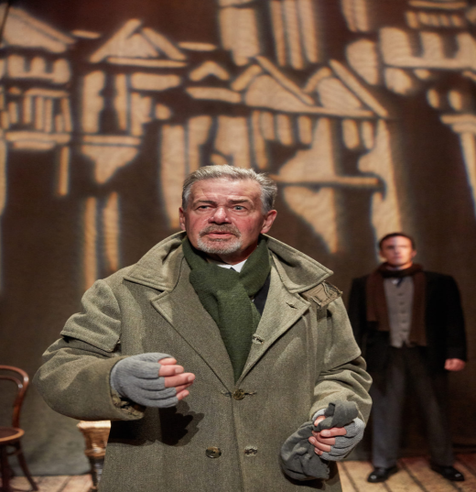
Mr Kipps as Keckwick
Mr Kipps narrating the play
Keckwick is a Pony and Trap driver that lost his father in an accident that killed the child of Jennet, the Woman in Black.
Mr Kipps will step forward throughout the play to narrate the play. The narration is also used to explain the settings that the audience cannot see.
Characterisation of “Keckwick”
Keckwick is played with a slow and deep voice. This can make the character appear to be a stereotypical bored and unintelligent man. It also makes him seem to not care or be affected by the events going on around him. This also highlights the difference between him and young Mr Kipps who is extremely changed from his experiences. Keckwick is also hunched over to show that his job is changing his posture and also shows an older character.
Characterisation of Mr Kipps narrating
The narration is clear with a pace which is appropriate to understand, neither too slow so that we do not get bored and not too fast so that we cannot understand him.
When he does use pick up the pace, the narration has excellent clarity so that we can clearly hear what is being said. The fast pace of the dialogue helps to create tension and an element of danger.

