Slide 1
Sound
Set
Design Elements
Lighting

Slide 2
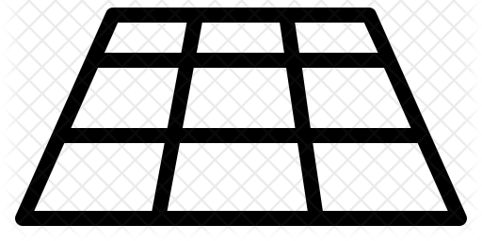
Vocal
Body/Physical
Performance Skills
Levels/Space/Positioning

Slide 3
Body
Gestures
Physical Skills
Movement

Slide 4
Staging
Space
Production
Elements
Costume

Slide 5
Cultural
Social
Context
(Background to Play)
Historical

Slide 6
Sound
Volume
Vocals
Live
SFX
Recorded

Slide 7
Vocals
Volume
Use of silence
Tone
Pace
Accents

Slide 8
Set
Stage Furniture
Back drops
Raised staging/ platforms
Structures/ Scaffolding

Slide 9
Props
Puppets
Hand held objects

Slide 10
Lighting
Intensity
Type
Colour
Gobos

Slide 11
Staging

Slide 12
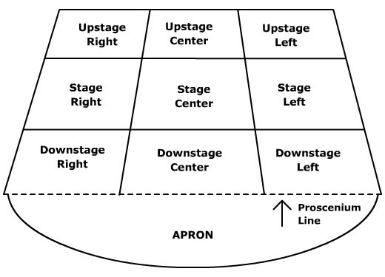
Stage Positioning
AUDIENCE

Slide 13
Styles/ Genres
Tragedy
Comedy
Melodrama
Documentary Theatre
Naturalism
Commedia Dell’Arte
Physical Theatre
Epic Theatre

Slide 14
Roles in the Theatre
Technician
Playwright
Lighting Designer
Performer
Sound Designer
Understudy
Set Designer
Theatre Manager
Puppet Designer
Costume Designer
Stage Manager

