Slide 1
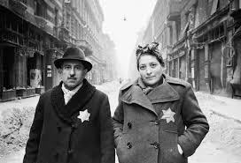
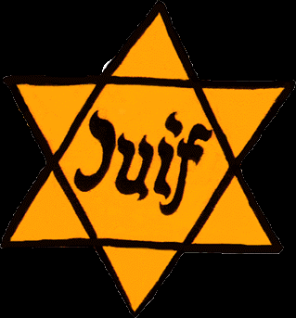
Historical Context
The Jewish people in Europe have had a troubled history and suffered persecution and violence for centuries.
By the beginning of WWI, however, Jews in Western Europe has acquired equal civil rights and become prominent and respected members of their communities.
Hitler was democratically elected Chancellor in January 1933 and soon passed an ‘enabling law’ which consolidated his power into a dictatorship.
There followed a series of changes in the law which began to remove the rights of Jewish people. This legislature prepared the ground for the creation of the Ghettos in 1942 and ultimately to Hitler’s Final Solution to ‘the problem of the Jews’.

Slide 2
Historical Context

Slide 3
Historical Context

Slide 4
The Warsaw Ghetto
The Warsaw Ghetto was established in 1940. Jewish people were evicted from their homes, stripped of their possessions and jobs and forced to wear armbands with the yellow star.
They were moved to specific streets in a walled area of the city and could only leave the ghetto with a special permit.
The ghetto represented 2.4% of the area of the city of Warsaw, yet it held 30% of the city’s population

Slide 5
Life in the Ghetto
The ghettos were essentially large prison camps, controlled and well guarded by the German police to ensure that there was no contact between the Jewish and non-Jewish population of the city.
Any Jews caught outside the ghetto could, by law, be shot on sight and the penalties for those outside the ghetto who didn’t inform on Jews were severe.
The Jewish people within the ghetto were entirely dependent on the German authorities who controlled the amount of food, medicine, and other vital supplies allowed into the ghetto.
The ghetto was severely overcrowded; at its height, the population reached 490,000. Conditions were unbearably cramped and families were crowded together without adequate food or water.
Medical supplies were severely limited and many children and adults died of disease which spread quickly within the close confines. Food was scarce and by the start of 1941 two thousand people a month were dying of starvation. Many others died from casual executions carried out by the Nazis

Slide 6
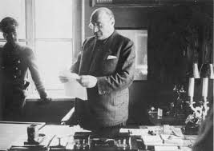
Maintaining Order in the Ghetto
The Nazi’s created a Judenrat or council for each ghetto to carry out their orders and to act as the go-between between themselves and the Jewish people. The head of the Warsaw Judenrat was Adam Cerniakov.
Jewish councils were often torn between their responsibility to help their fellow Jews as much as possible and their instructions to carry out the orders of the Nazi authorities, often at the expense of their fellow Jews.
Towards the end of the end of the war, the Judenrat was forced to deliver Jews to the deportation trains that were taking them to their deaths

Slide 7
JANUSZ KORCZAK
Janusz Korczak (pen name of Henryk Goldszmit)
was an inspirational teacher and writer who cared
passionately about the rights and wellbeing of
children.
His books were well known in Poland and
many other countries of the former Eastern Bloc
long before the outbreak of the Second World War.
Korczak spoke and wrote extensively about the right
of each child, regardless of background or social
standing, to be a happy and constructive citizen.
He was committed to social justice and believed that
education had a vital role to play in this, and gained
an international reputation for what were then
Ground breaking ideas.
Korczak believed that children best understand their
own needs, aspirations and emotions and should have
the right to have their opinions respected by adults.

Slide 8
KORCZAK’S ORPHANS
Prior to the war, Korczak was the leader of two orphanages in Poland, one for Polish Jewish children, the second for Polish Catholic children. When the Warsaw ghetto was created, Korczak was forced to move the Jewish orphanage within the ghetto walls. Korczak chose to stay with the children in the ghetto, looking after over 200 Jewish children aged between seven and fourteen.
Korczak continued to run the orphanage with the same democratic philosophy as he had before the war. The orphanages he led were run in collaboration with the children; they had their own parliament, court and newspaper and were in charge of deciding who could stay and who had to leave the orphanage.
On the 5th August 1942 Dr Korczak and his children were deported to Treblinka. Korczak was given the opportunity to escape and save himself; however he refused and instead stayed with his orphans to the very end.

Slide 9
KORCZAK’S LEGACY
While he lived and died at a time and in a place where the abuse of all human rights was on a colossal scale, Korczak’s greatest legacy is perhaps the inspiration he provided for the promotion of children’s rights worldwide, through not only his books, speeches and writings, but also by his personal example.
“The Court may become the nucleus of emancipation, pave the way to a constitution, make unavoidable the proclamation of the Declaration of Children’s Rights”
Most of Korczak’s ideas were included in the UNESCO Charter for Children’s Rights after the war.

Slide 10
How would you use acting skills to play the role of Dr Korczak?
How would you use costume to play the role of Dr Korczak?

