Slide 1
MAKE A STATEMENT
PHOTOGRAPHERS TO START YOU OFF.

Slide 2
This is a SELF-DIRECTED project, which requires you to construct your own focused aims and produce a succession of ideas based on your own theme.
Initial task:
Firstly, choose a photographer from the small selection on the next few slides, this will encourage you to begin making connections with other artists’ work and your own.
Do a short study and response of your own, based on their work:
Do all of their photographs have a similar theme?
What statement is your chosen photographer making?
How could you use them to make a different statement in your work?
What technical aspects of photography have they used?
What do you find the most interesting element of their work?
How could you achieve a similar finish to them in your work?

Slide 3
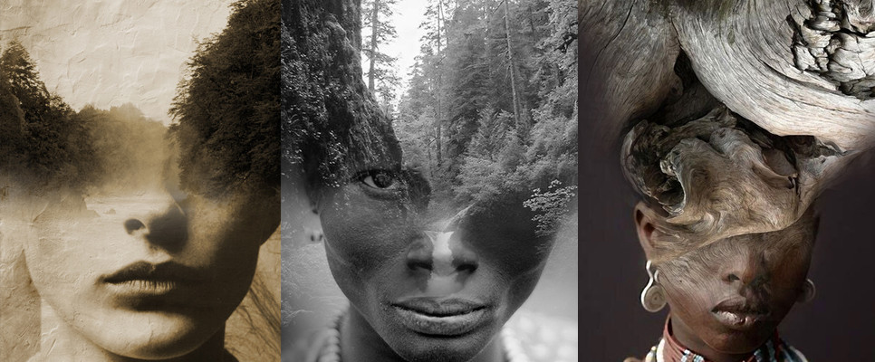
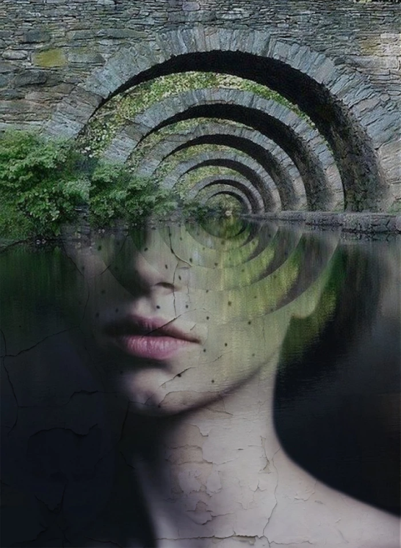
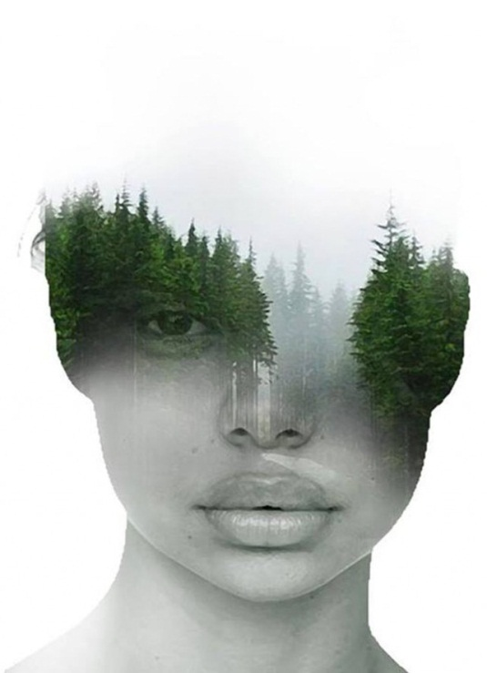
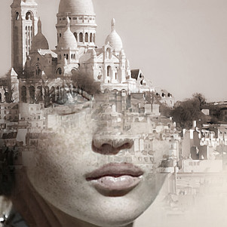
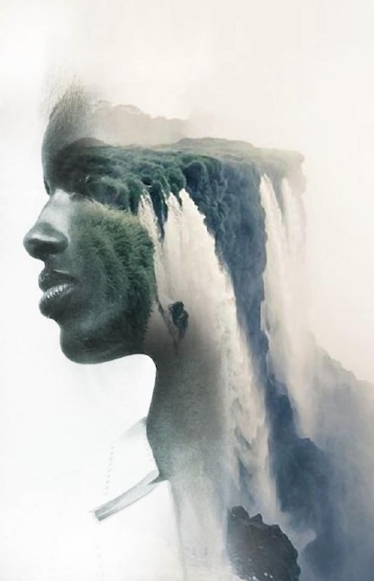
ANTONIO MORA

Slide 4
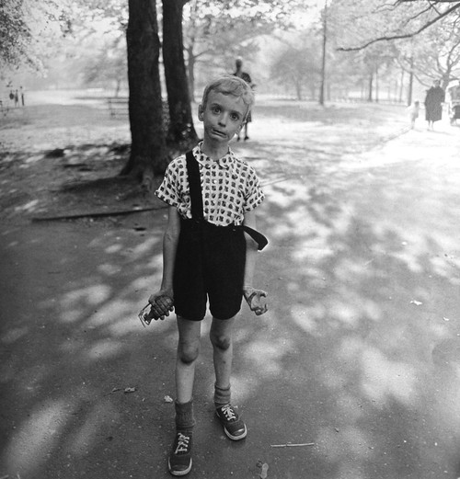
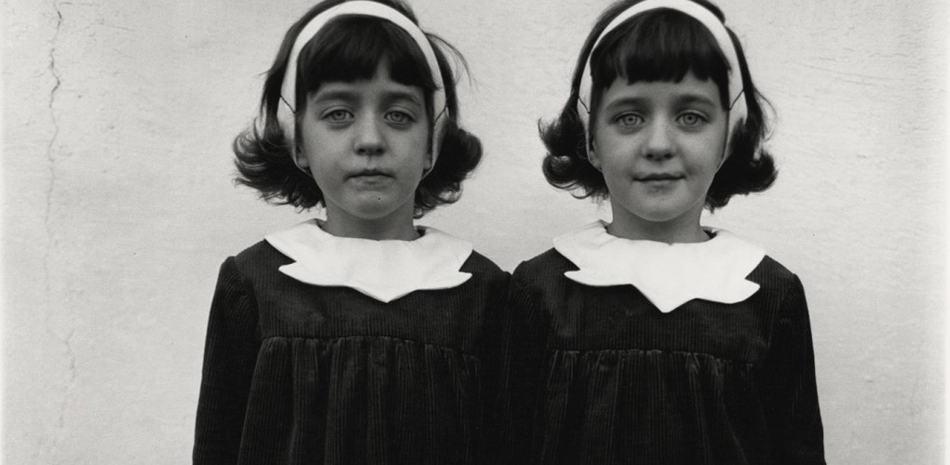
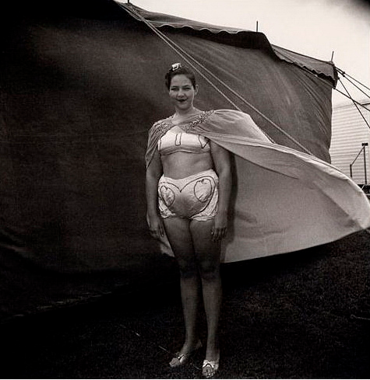
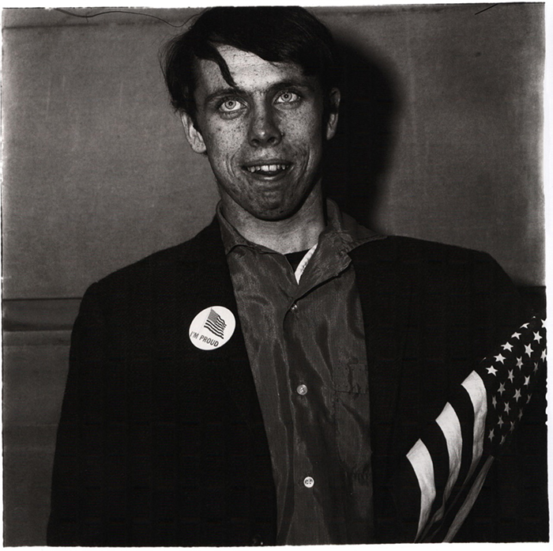
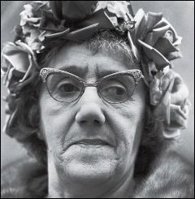
DIANE ARBUS

Slide 5
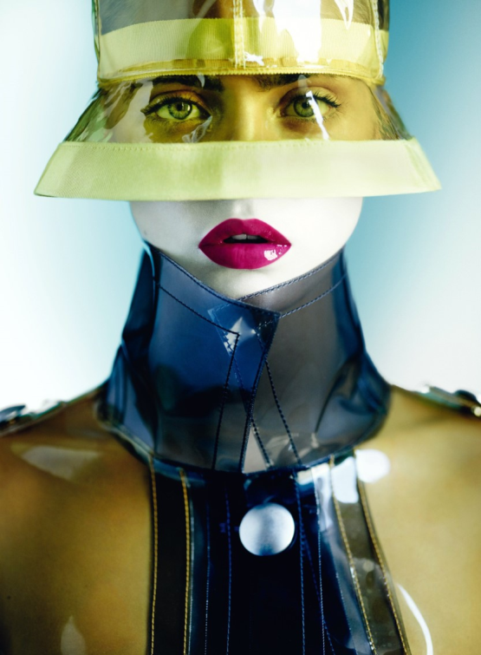
MARIO TESTINO

Slide 6
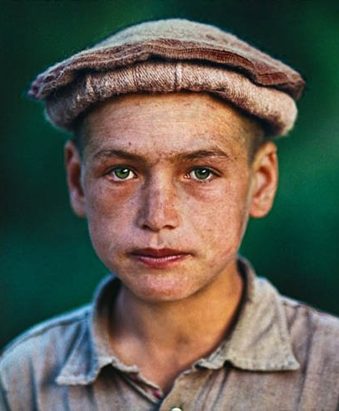
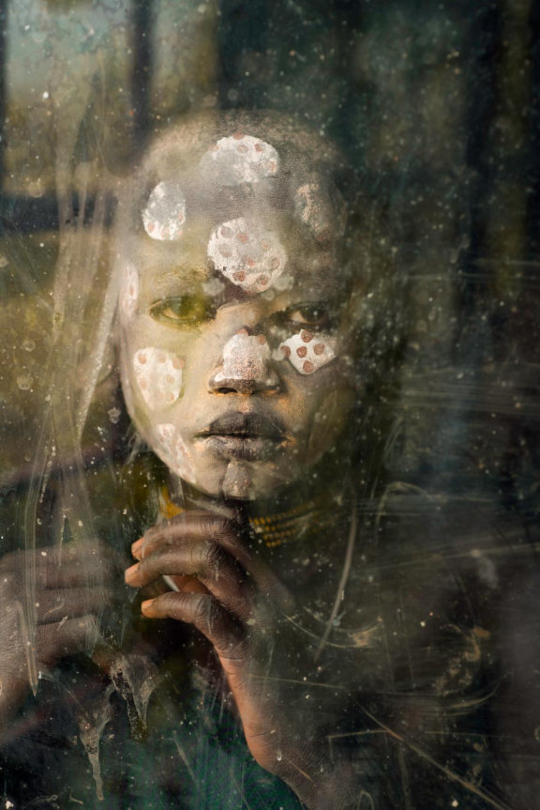
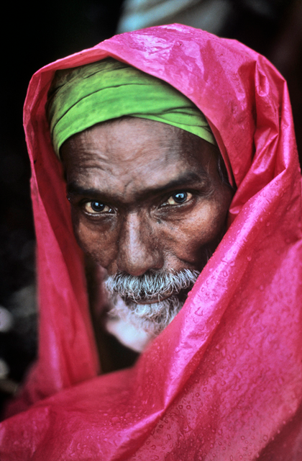
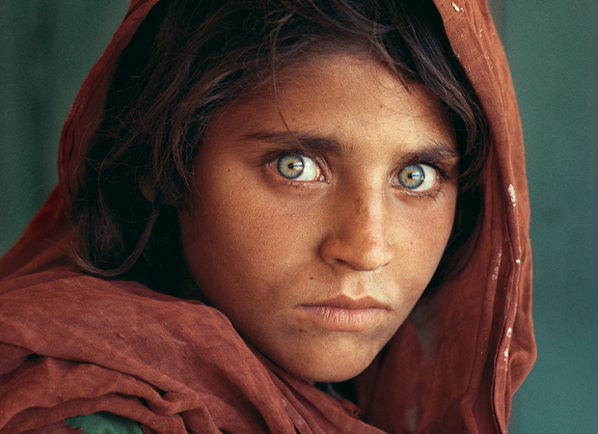
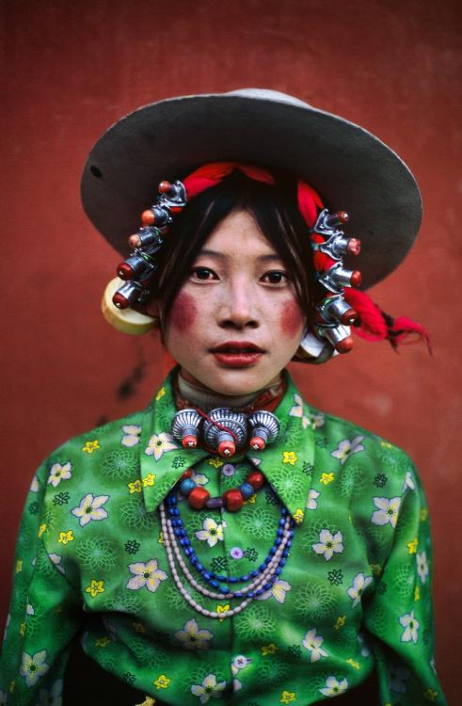
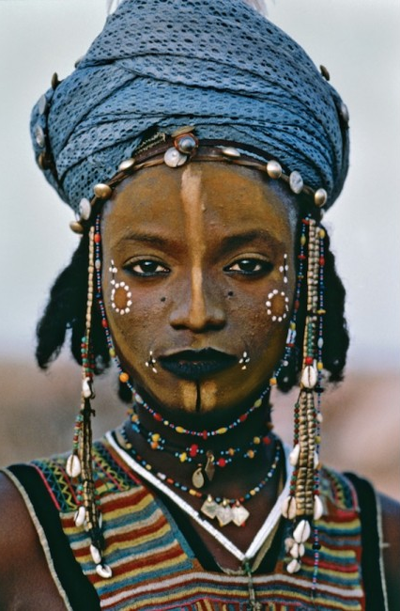
STEVE
McCURRY

Slide 7
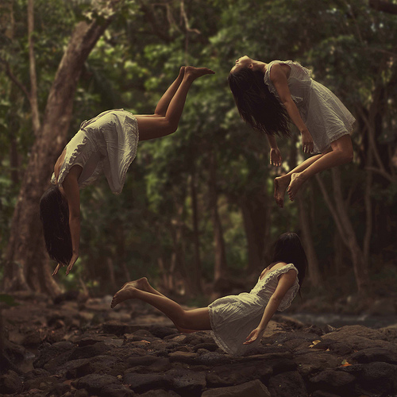
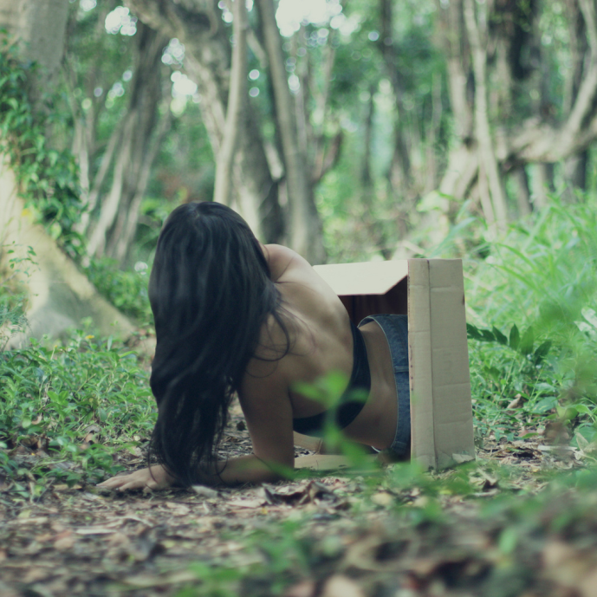
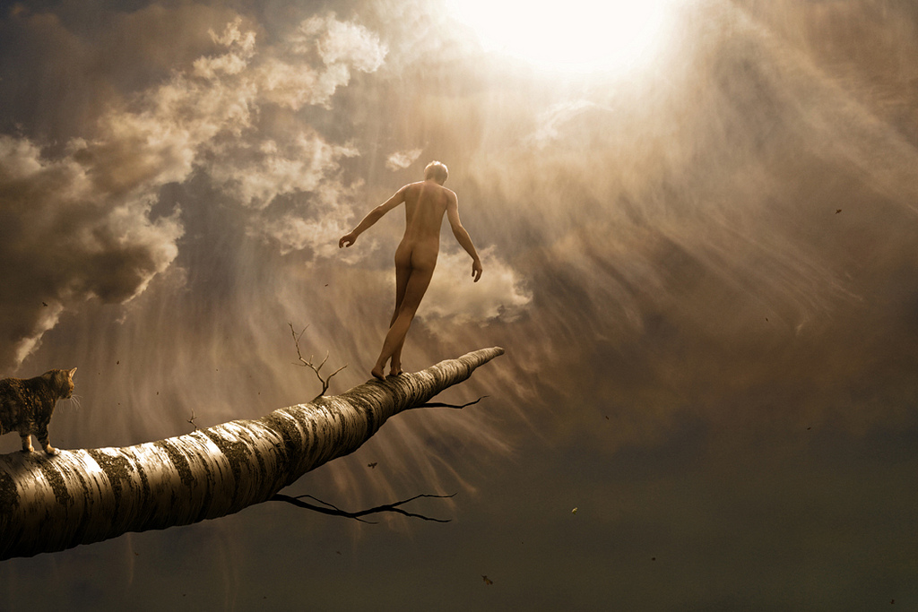
<<<<< KYLIE WOON >>>>>

Slide 8
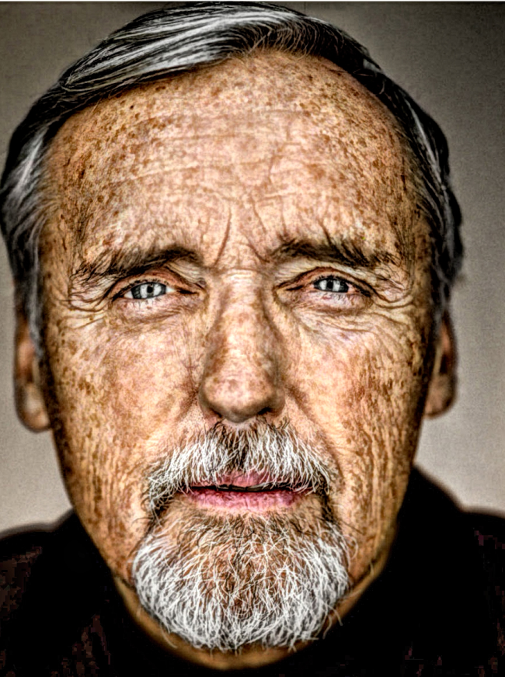
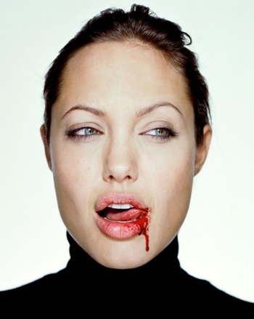
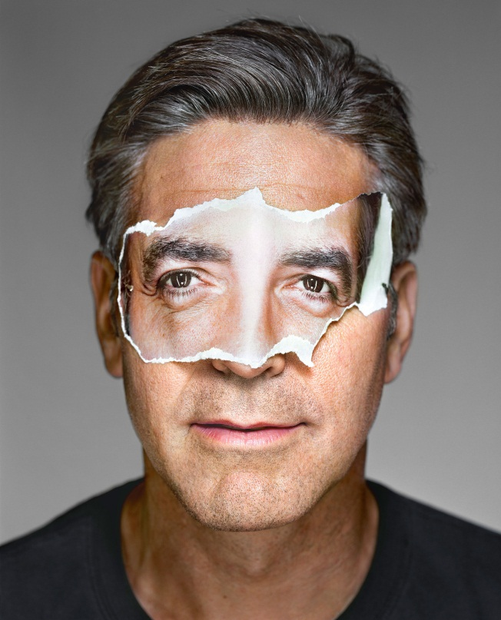
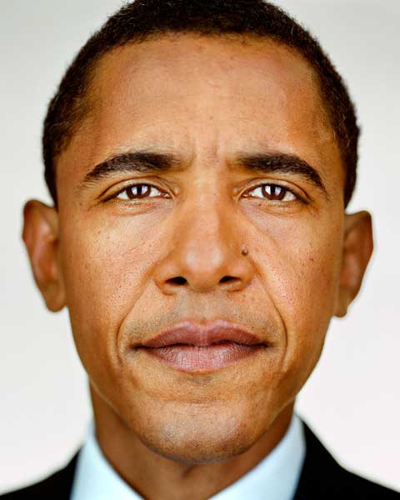
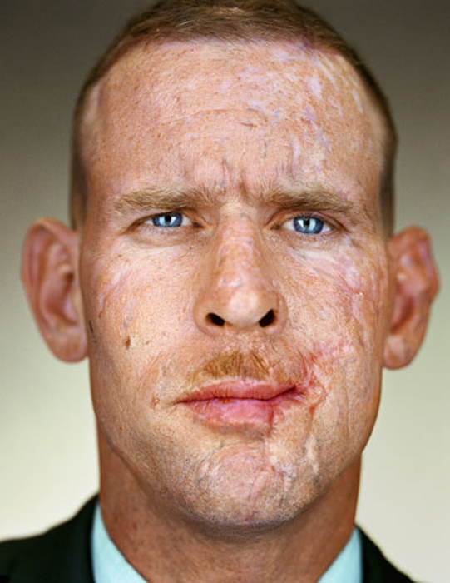
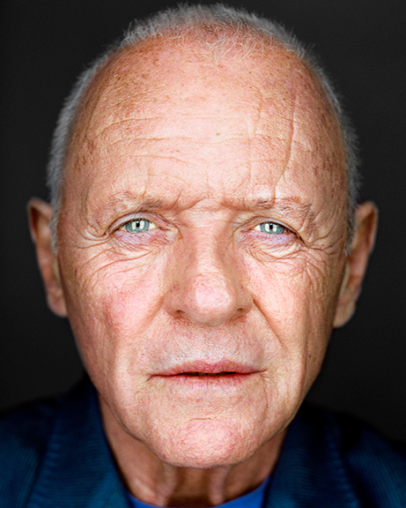
MARTIN SCHOELLER
MARTIN SCHOELLER
MARTIN SCHOELLER
MARTIN SCHOELLER
MARTIN SCHOELLER
MARTIN SCHOELLER
MARTIN SCHOELLER
MARTIN SCHOELLER
MARTIN SCHOELLER
MARTIN SCHOELLER
MARTIN SCHOELLER
MARTIN SCHOELLER
MARTIN SCHOELLER
MARTIN SCHOELLER
MARTIN SCHOELLER
MARTIN SCHOELLER
MARTIN SCHOELLER
MARTIN SCHOELLER
MARTIN SCHOELLER
MARTIN SCHOELLER
MARTIN SCHOELLER
MARTIN SCHOELLER
MARTIN SCHOELLER
MARTIN SCHOELLER
MARTIN SCHOELLER

Slide 9
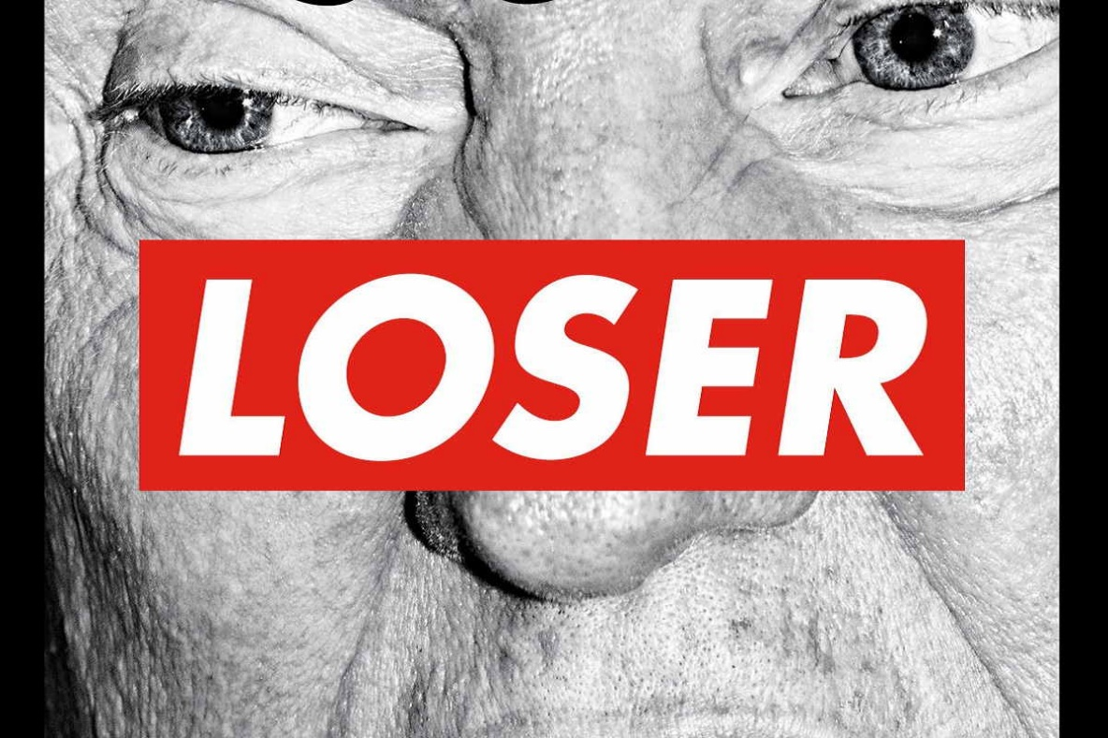
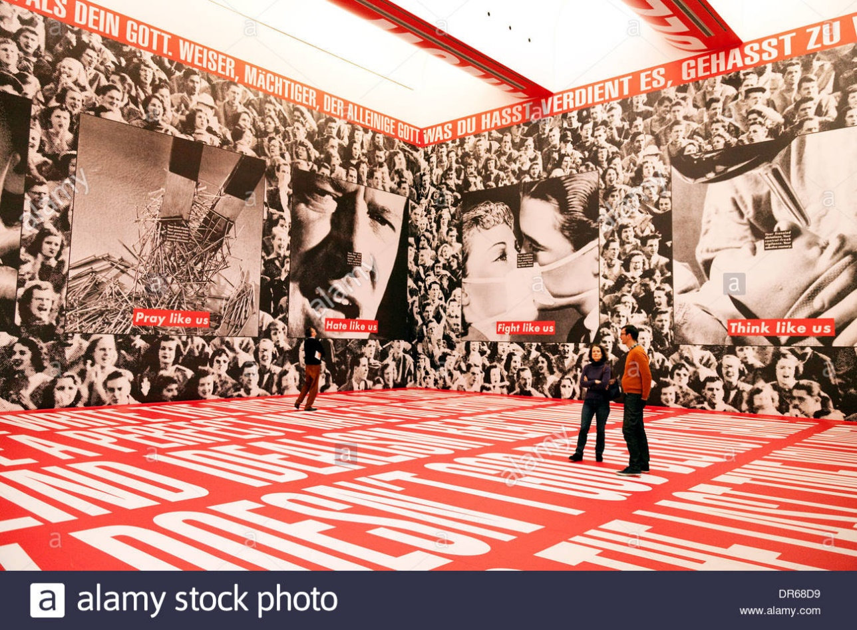
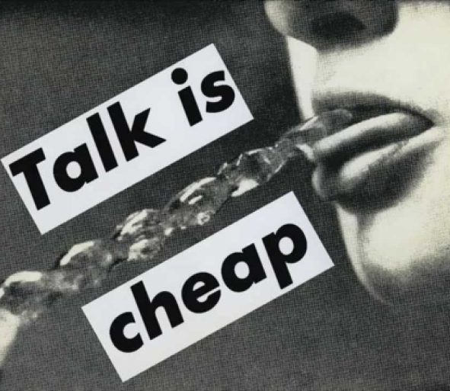
BARBARA
KRUGER

Slide 10
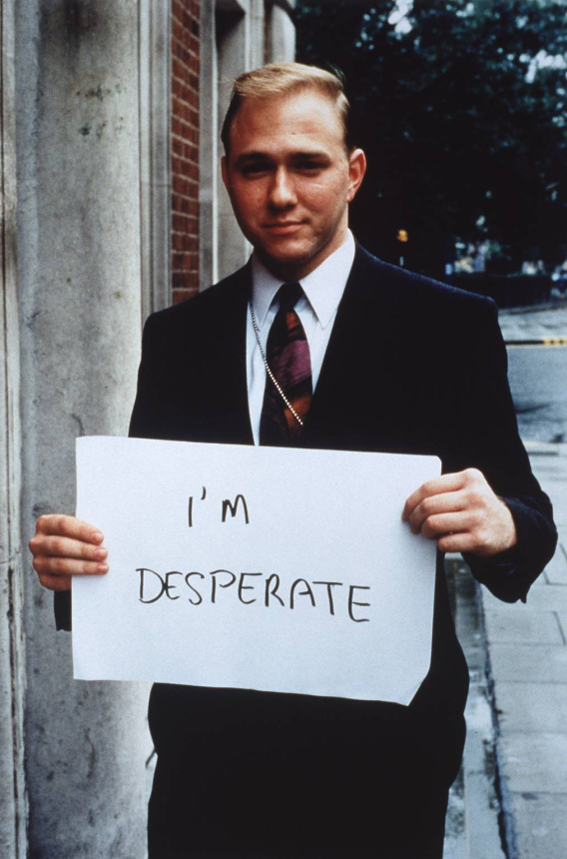
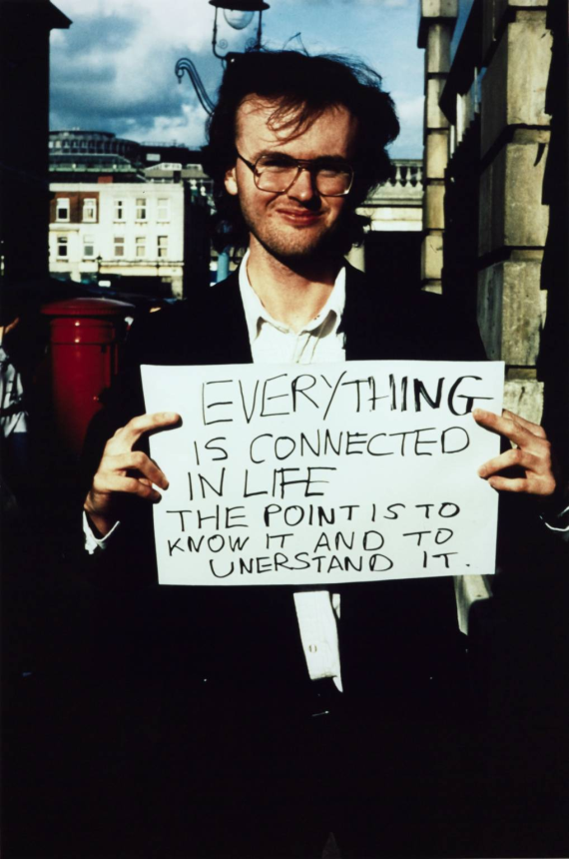
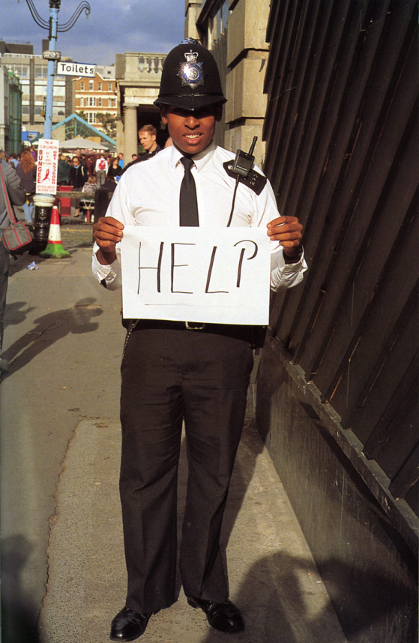
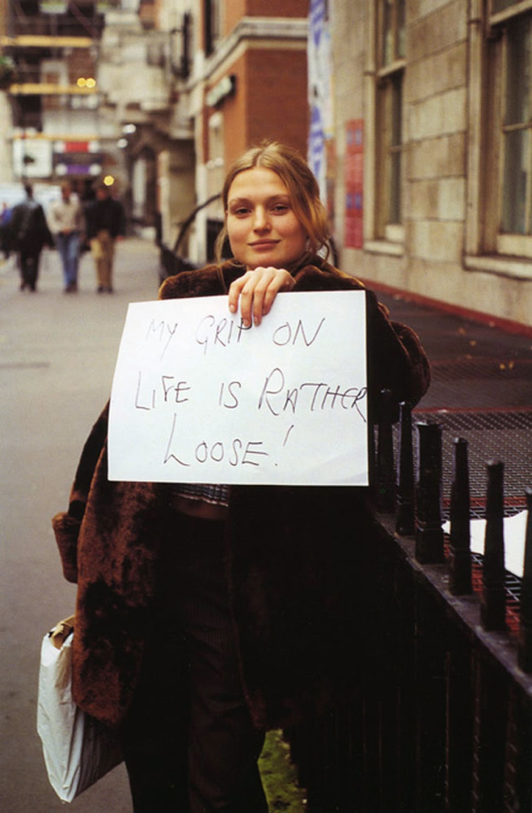
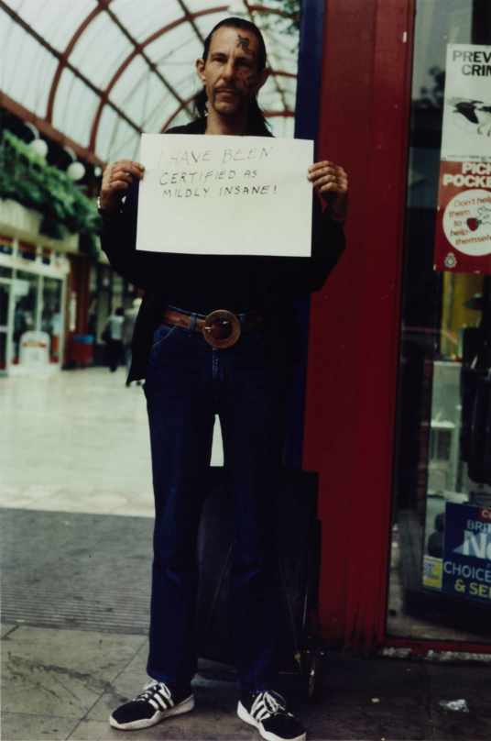
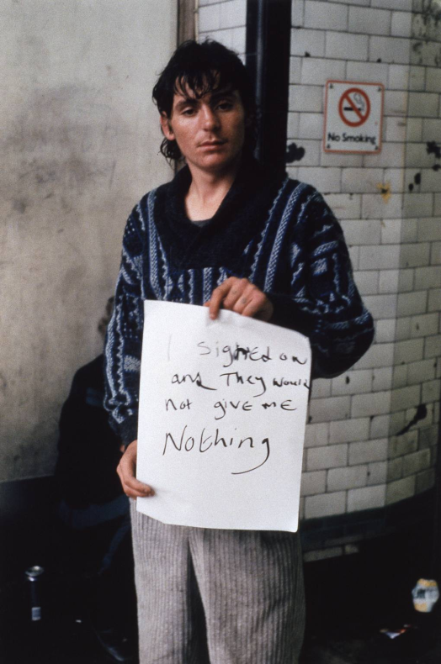
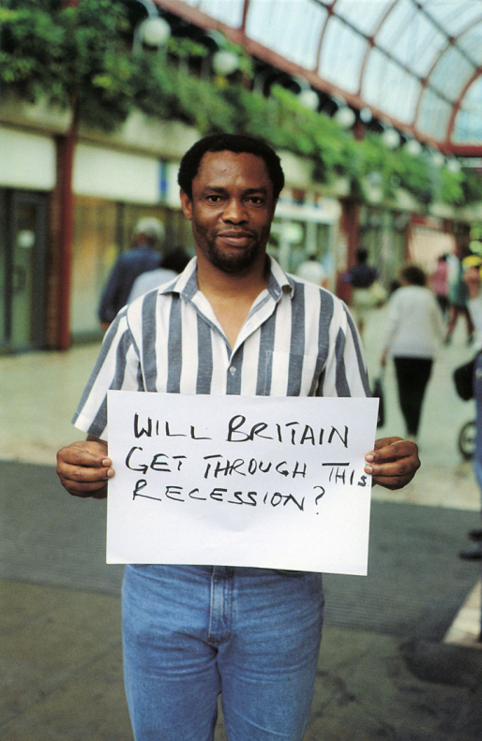
GILLIAN WEARING

Slide 11
‘Make a Statement’checklist
You should have…
A TITLE PAGE: ‘MAKE A STATEMENT’.
2 ARTIST STUDIES (MINIMUM) THAT WILL HELP YOU TO DEVELOP IDEAS OF YOUR OWN.
A PAGE ABOUT WHAT YOUR STATEMENT IS.
IMAGES RELATING TO YOUR STATEMENT, THESE COULD BE PHOTOS FROM PHOTOGRAPHERS OR SOME IMAGES TO HELP WITH IDEAS.
A spider diagram to show how you are developing your ideas.
4 IDEAS RELATING TO YOUR STATEMENT. (include drawings).
HOW YOU PLAN TO DEVELOP THESE IDEAS, WHAT YOU WILL NEED AND WHAT TECHNICAL ASPECTS YOU WILL BE USING.

