Slide 1
Practical exam – Book 2
Name -

Slide 2
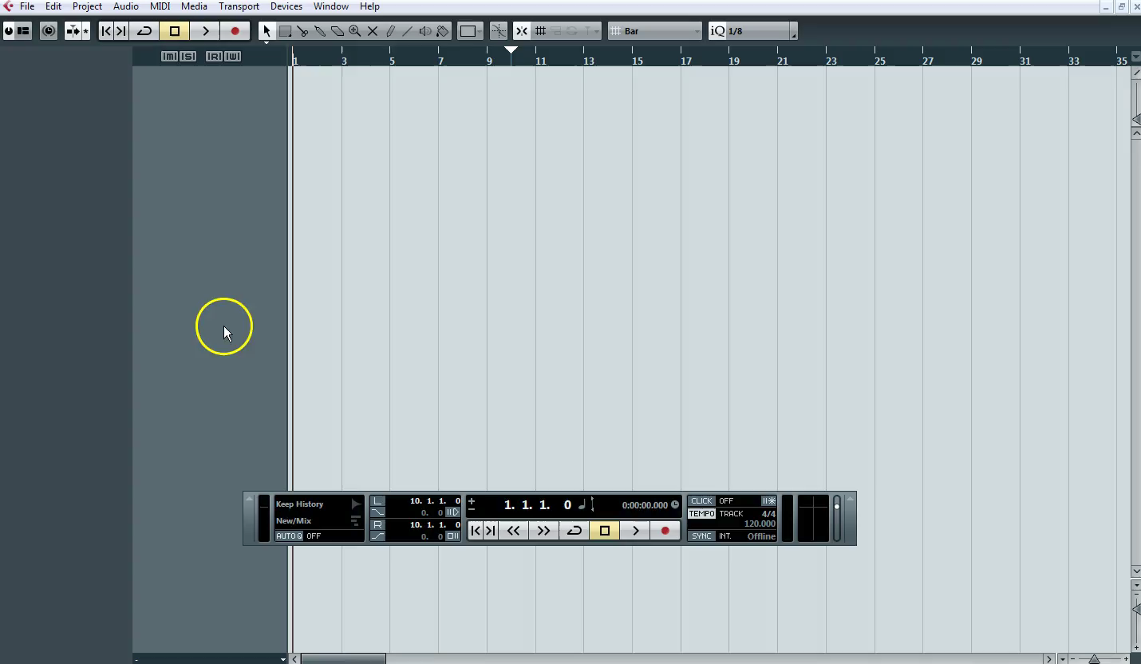
Importing MIDI
1 – Watch the clip below

Slide 3
Importing MIDI
1 – Change your tempo
(p) Written explanation of your process (m) Why do you need to move the MIDI track to a software instrument track?
P
M
2 - Insert Screenshots to evidence your work

Slide 4
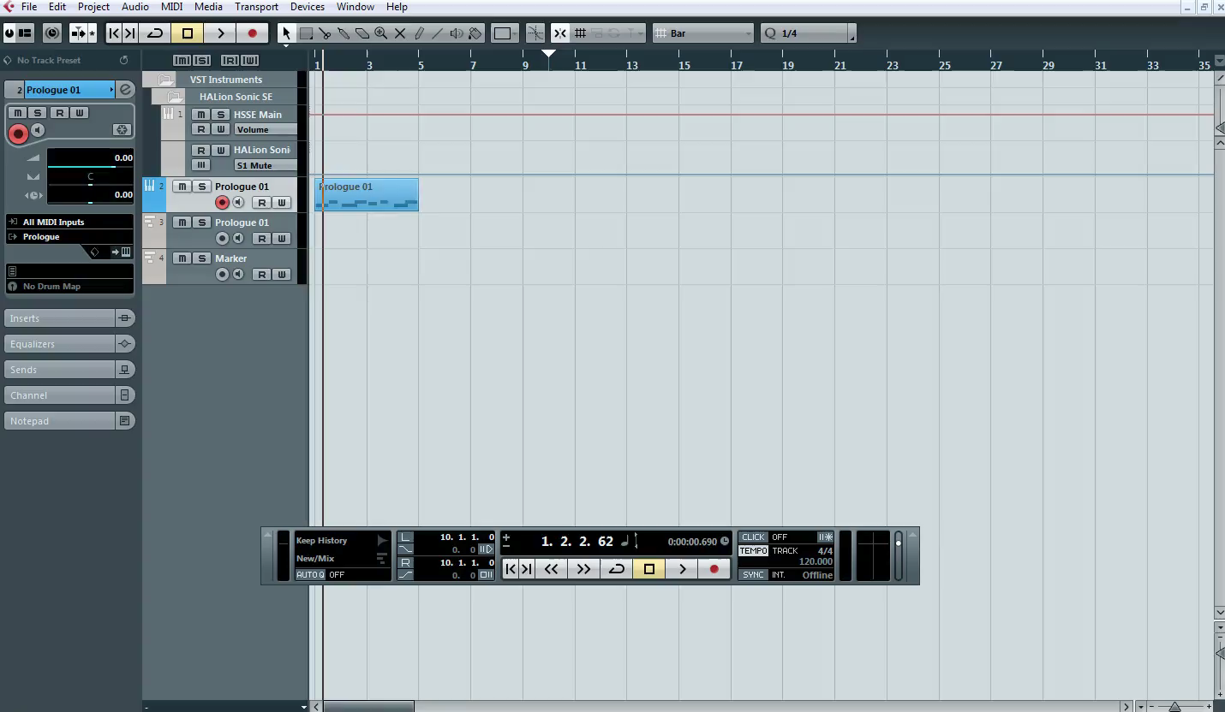
Quantise
1 – Watch the clip below

Slide 5
Quantise
1 – Change your tempo
(p) Written explanation of your process (m) What would the different quantise fractions do?
P
M
2 - Insert Screenshots to evidence your work

Slide 6
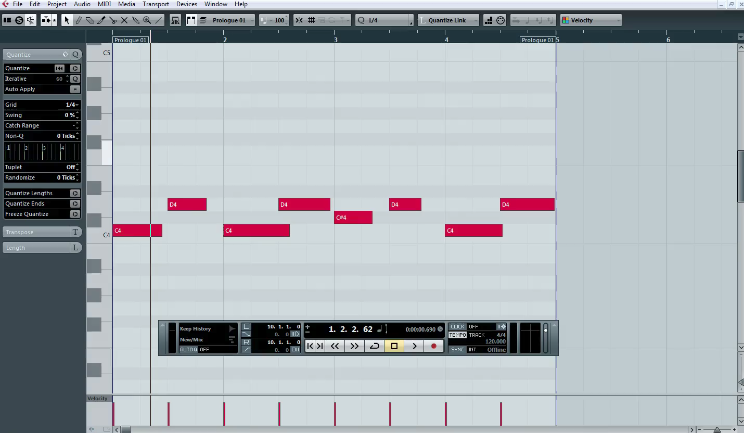
Pitch Errors
1 – Watch the clip below

Slide 7
Pitch Errors
1 – Create 3 stereo audio tracks and one mono audio track
(p) - Written explanation of your process (m) How can you tell what note is out of tune and needs to be moved?
P
M
2 - Insert Screenshots to evidence your work

Slide 8
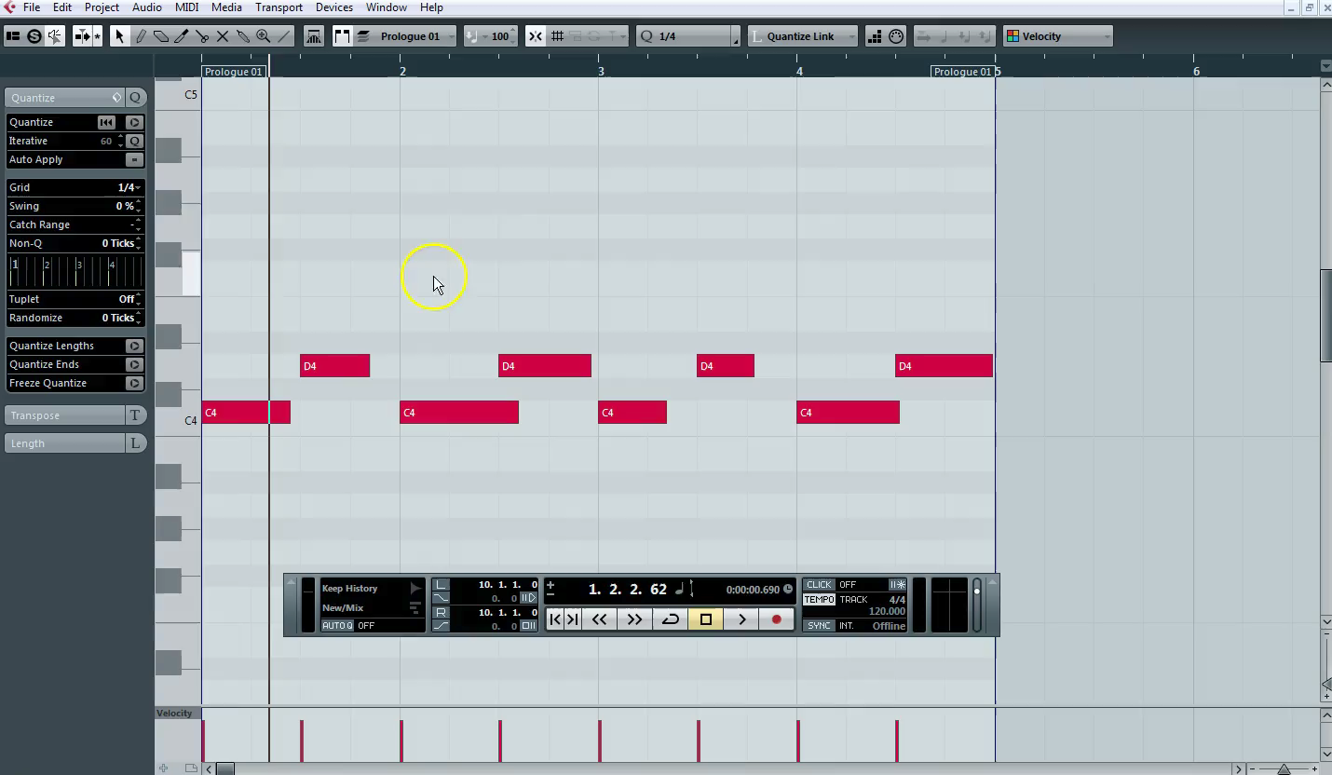
Duplicate samples
1 – Watch the clip below

Slide 9
Duplicate samples
Create 2 different types of software tracks
(p) Written explanation of your process (m) What other options do you have to reproduce a sample in Cubase?
P
M
Insert Screenshots to evidence your work

Slide 10
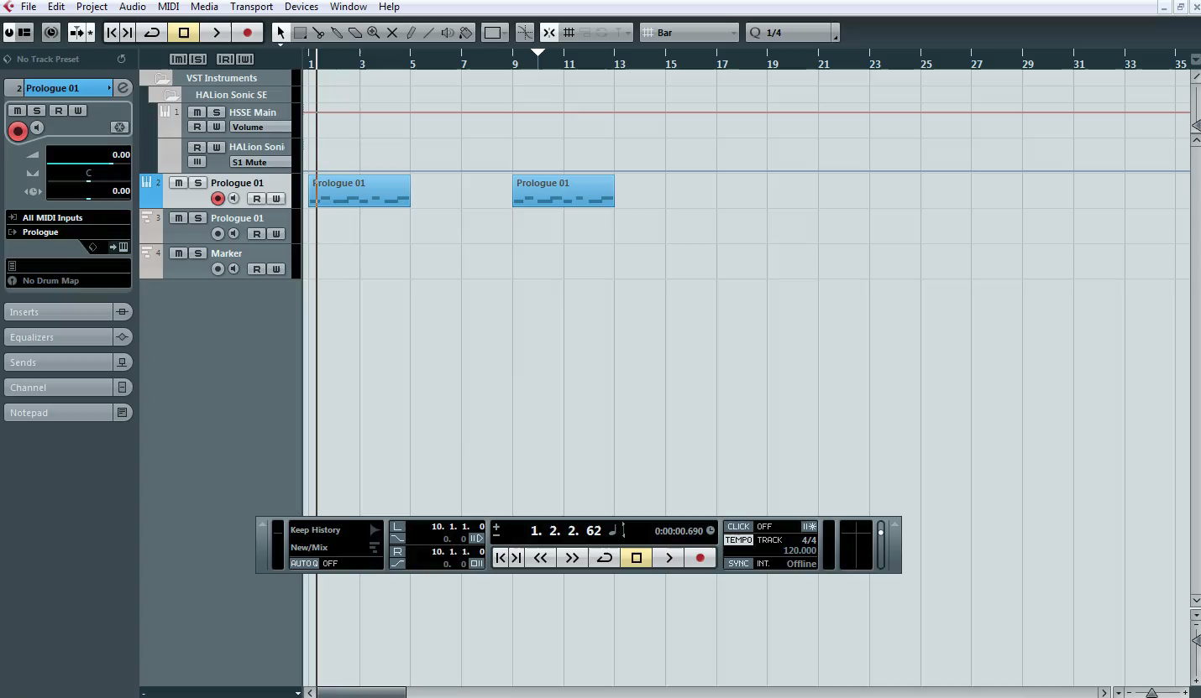
Exporting the song
1 – Watch the clip below

Slide 11
Exporting the song
Show the inputs and outputs for your project
(p) Written explanation of your process (m) What should you do with the exported track at the bottom of your project (D) Why would you do this to the exported track at the bottom?
P
M
D
3 - Insert Screenshots to evidence your work

Slide 12
Music Technology
Date …. / …. / ….
Grade | Achieved?
NYA
Pass 4
MERIT 5.5
DIST 7
What you did not achieve from the workbook?
Strength
Target
Grade
Teacher Comment | Pupil Response
Q1. Explain ‘Setting the poles’ when exporting in Cubase | …
Q2. What is Quantise? | …
Q3. Duplicate is what? | …
Response & Challenge
Presentation
☺ 😐 ☹
Effort
☺ 😐 ☹

