Slide 1
Practical exam – Book 1
Name -

Slide 2
Configuration
Describe the technical features of your Digital Audio Workstation

Slide 3
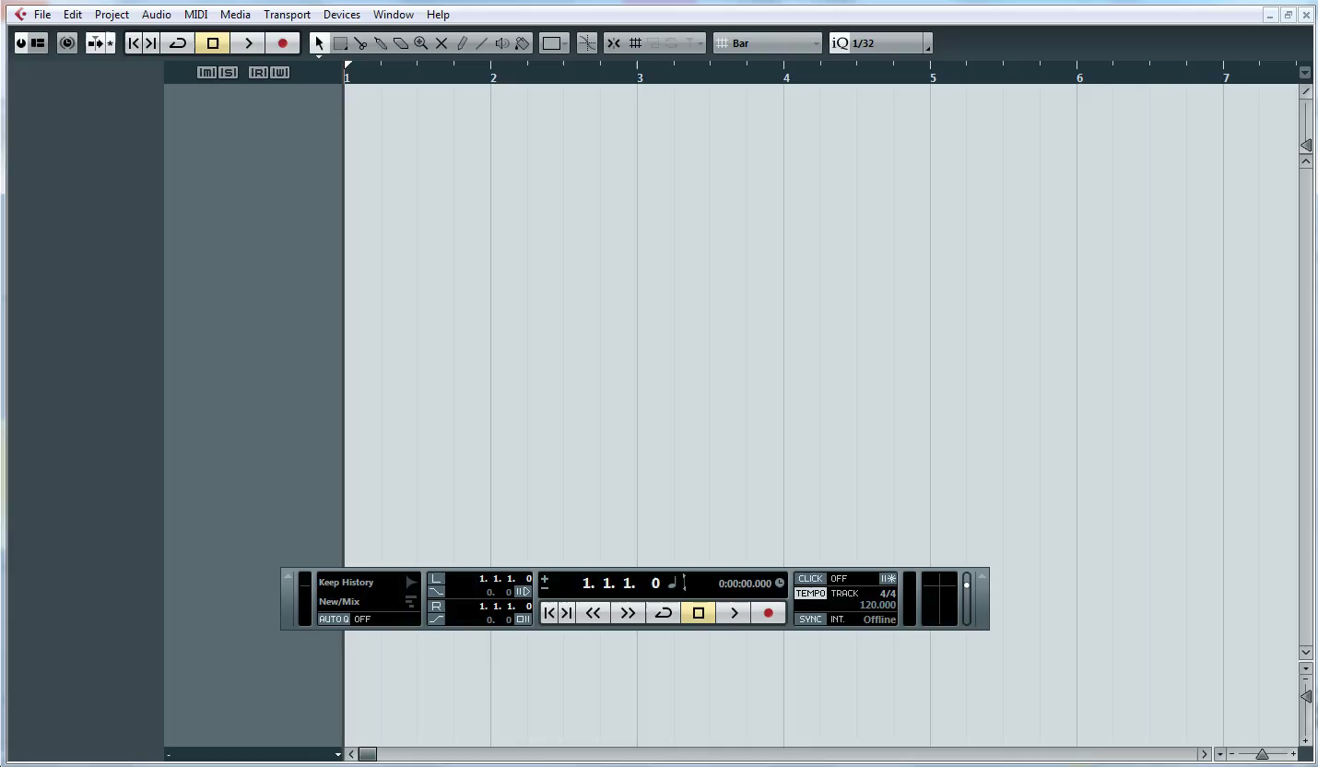
Changing Your Tempo
1 – Watch the clip below

Slide 4
Changing your tempo
1 – Change your tempo
(p) Written explanation of your process (m) What is the difference between a track tempo and a fixed tempo?
P
M
2 - Insert Screenshots to evidence your work

Slide 5
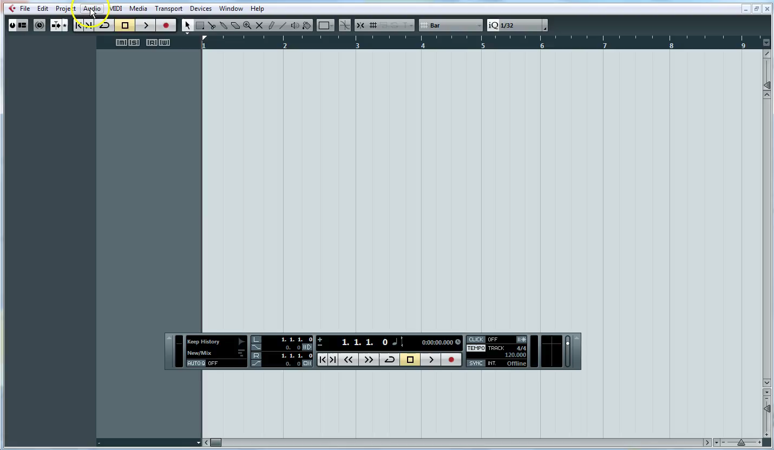
Creating Audio Tracks
1 – Watch the clip below

Slide 6
Creating audio Tracks
1 – Create 3 stereo audio tracks and one mono audio track
(p) - Written explanation of your process (m) What is the difference between a stereo and mono audio track?
P
M
2 - Insert Screenshots to evidence your work

Slide 7
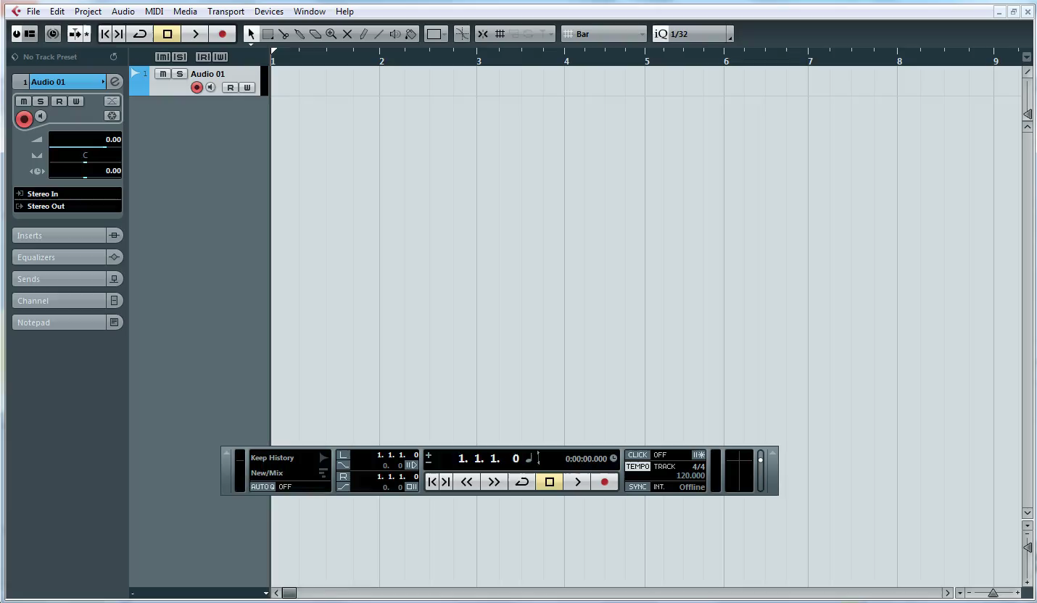
Create Software instrument tracks
1 – Watch the clip below

Slide 8
Create a software instrument track
Create 2 different types of software tracks
(p) Written explanation of your process (m) What is the difference between the synthesisers on Cubase?
P
M
Insert Screenshots to evidence your work

Slide 9
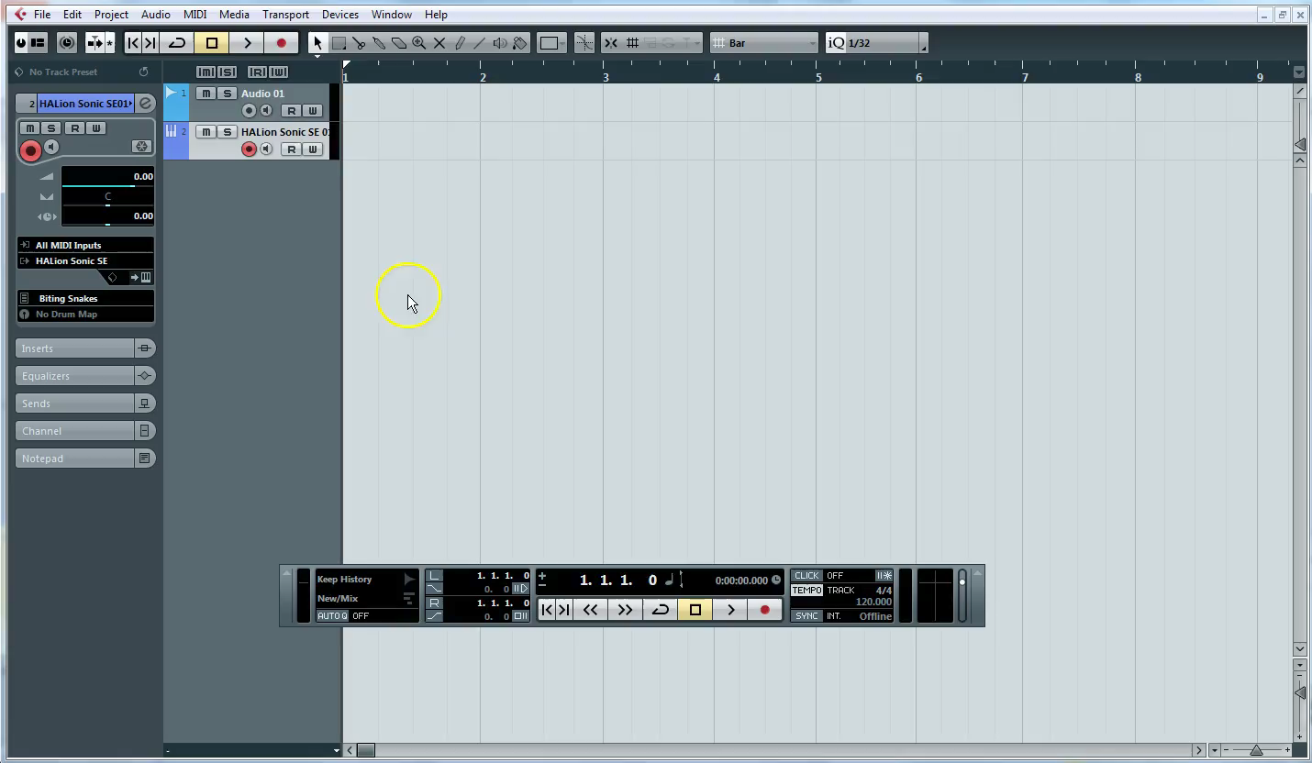
Audio Output
1 – Watch the clip below

Slide 10
Audio Output
Show the inputs and outputs for your project
(p) Written explanation of your process (m) What is the difference between and input and out (D) If I changed the microphone I was using where would this appear and why?
P
M
D
3 - Insert Screenshots to evidence your work

Slide 11
Music Technology
Date …. / …. / ….
Grade | Achieved?
2
3
4
5.5
7
What you did not achieve from the workbook?
Strength
Target
Grade
Teacher Comment | Pupil Response
Q1. What is a DAW? | …
Q2. What is MIDI | …
Q3. What are outputs? | …
Response & Challenge
Presentation
☺ 😐 ☹
Effort
☺ 😐 ☹

