Slide 1
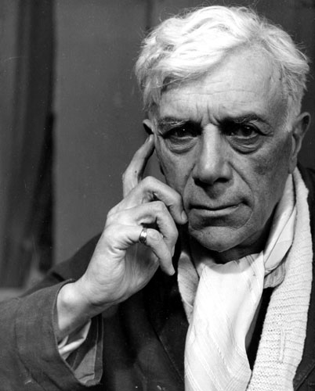
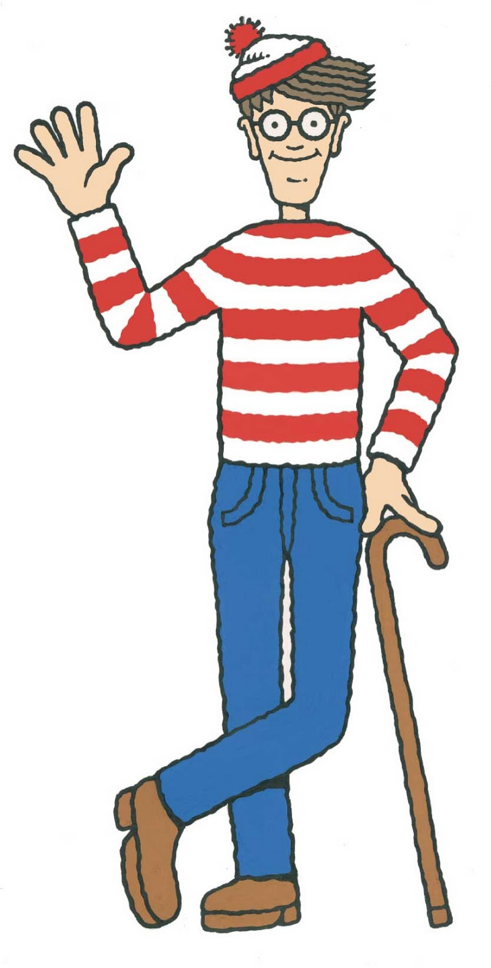
Georges Braque
1882-1963

Slide 2
What are we looking at?
Frames
Tone
Colour
Shape
Abstract
Cubism
Perspective and geometry
Subjective
Structural
Cultural
Post-modern

Slide 3
WHO?
Georges Braque was born in Argenteuil. He grew up in Le Havre and trained to be a house painter and decorator like his father and grandfather. However, he also studied serious painting in the evenings at the École des Beaux-Arts, in Le Havre, from about 1897 to 1899.
His earliest works were impressionistic, but after seeing the work exhibited by the Fauves in 1905, Braque adopted a Fauvist style. The Fauves, a group that included, Henri Matisse and Andre Derain among others, used brilliant colours and loose structures of form to capture the most intense emotional response.
Braque worked most closely with the artists Raoul Dufy and Othon Friesz, who shared Braque’s hometown of Le Havre, to develop a somewhat more subdued Fauvist style.
In May 1907, he successfully exhibited works in the Fauve style in the Salon des Independents. The same year, Braque’s style began a slow evolution as he came under strong influence of Paul Cezanne, who died in 1906.

Slide 4
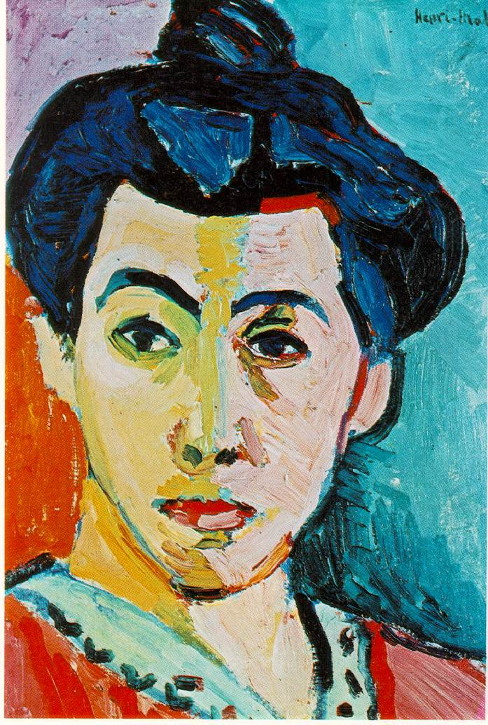
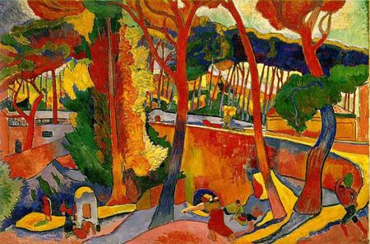
Henri Matisse, Green Stripe, 1905
Andre Derain: The Turning Road, L’Estaque-1906

Slide 5
Fauvism, What is it?
Fauvism flourished in the early 20th century.
These painters were the first to break away from Impressionism and with the older traditional methods of painting.
These artists were often spontaneous, had a subjective response to nature that was expressed in bold, undisguised brushstrokes and high-keyed, vibrant colours directly from the paint tube.
Henri Matisse and Andre Derain introduced this un-naturalistic colour and vivid brushstrokes into their paintings.

Slide 6
Cubism, What is it?
Cubism was a truly revolutionary style of modern art developed by Pablo Picasso and Georges Braque.
Cubism emerged from Paul Cezanne’s research in warm and cool colours, which suggests foreground and background relationships, as well as the increased accessibility to ‘primitive’ art- works from Africa and Oceania.
It was the first style of abstract art which evolved at the beginning of the 20th century in response to a world that was changing with unprecedented speed.
Cubism was an attempt by artists to revitalise the tired traditions of Western art which they believed had run their course.
Challenged conventional forms of representation such as perspective, which has been the rule since the Renaissance.

Slide 7
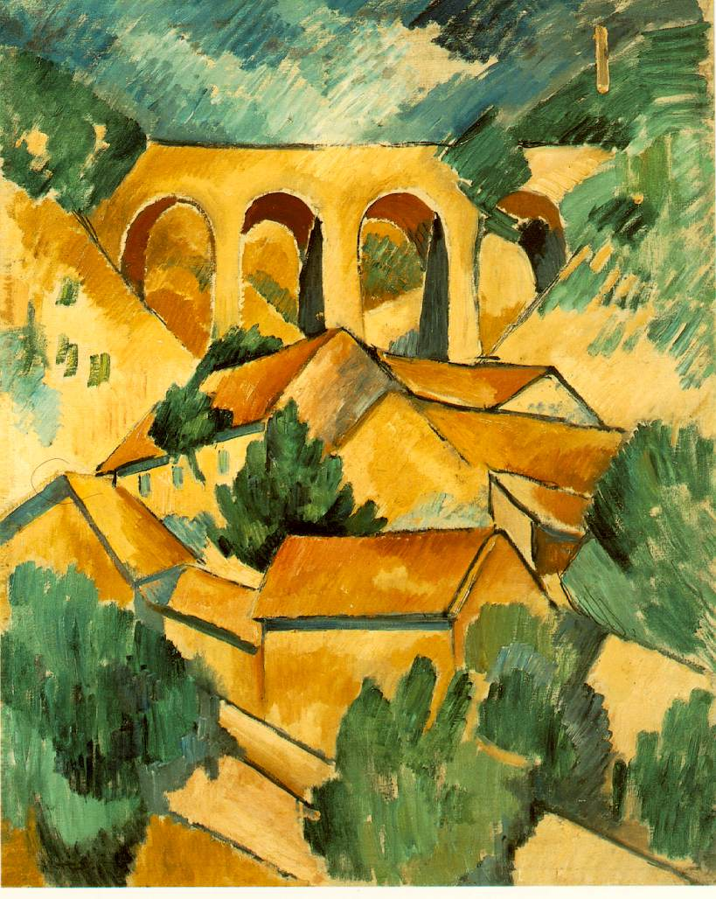
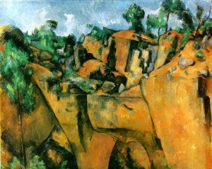
Georges Braque, The Viaduct at L’Estaque - 1907
PAUL CÉZANNE (1839-1906)'Bibemus Quarry', 1895 (oil on canvas)
Task:
We are going to as a class deconstruct Georges Braque image together.
Notes:
Scaffold?

Slide 8
Post-modern frame how?
What words could you use to describe this image?
Challenges ideas?
Cubist?
Shape and Geometry?
Georges Braque, The Viaduct at L’Estaque - 1907

Slide 9
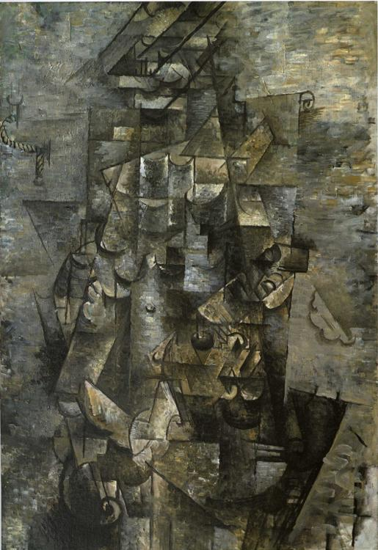
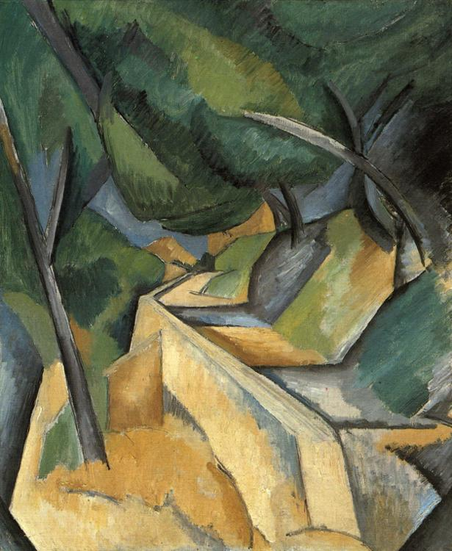
Is this the same artist?
Road near L'Estaque, 1908 by Georges Braque
Man with a guitar, 1911 by

Slide 10
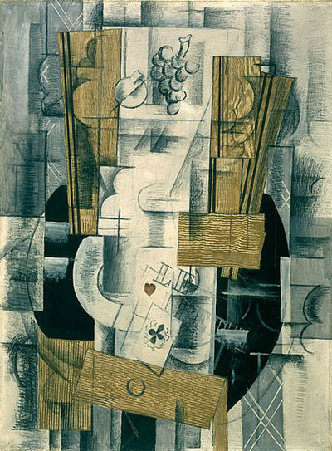
Cubism emphasises on the way one sees (perceives) reality. Cubist works often present this idea through displaying multiple viewpoints simultaneously for the same object. There are three main stages for Cubism: Facet Cubism, Analytical Cubism and Synthetic Cubism.
Georges Braque,
Compotier et cartes
(Fruit Dish and Cards) , 1913,
Paris Oil, pencil and charcoal on canvas,
81 x 60cm

Slide 11
Toward the end of Analytical Cubism Braque and Picasso realised that their painting had become increasingly abstract and less readable by the audience. The work also display little to no reference to reality. It was at this time that the artists decided to introduce readable signs by using papier collé. The artists glued newspaper, manuscript, cane and wood veneer to their artworks as the audience could easily see the reference to the real world. This third stage of Cubism is termed Synthetic Cubism. This stage shifts focus to the issue of painting’s connection with reality by using objects as symbols and signs.

Slide 12
How Braque came into his own style:
Over the years Braque received inspiration from various artists.
In 1908-1913 his paintings began to reflect his new interest in geometry and simultaneous perspective.
Braque conducted an intense study of the effects of light, perspective and the techniques that artists use to represent these effects.
What you need to Focus on:
Subjective or Structural Frame
Colour
Shape
Tone
Form
Perspective
Task:
Now you know a bit of background about cubism, fauvism and Georges Braque
Compare the similarities and differences of Georges Braque paintings:
Georges Braque, The Viaduct at L’Estaque – 1907
Georges Braque, Women with a guitar- 1913
Notes:
Scaffold?

