Slide 1
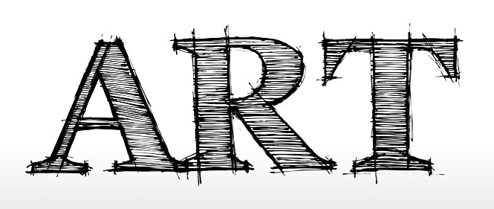
Basic Elements also known as the Formal elements
Teacher:
Name:
Class:

Slide 2
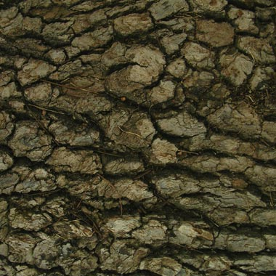
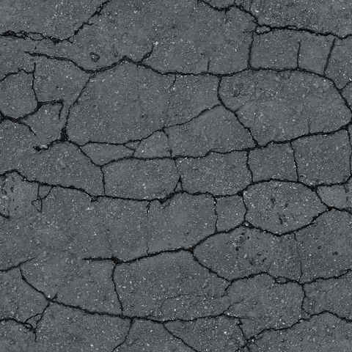
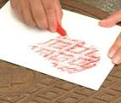
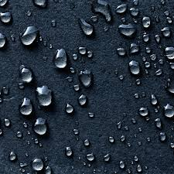
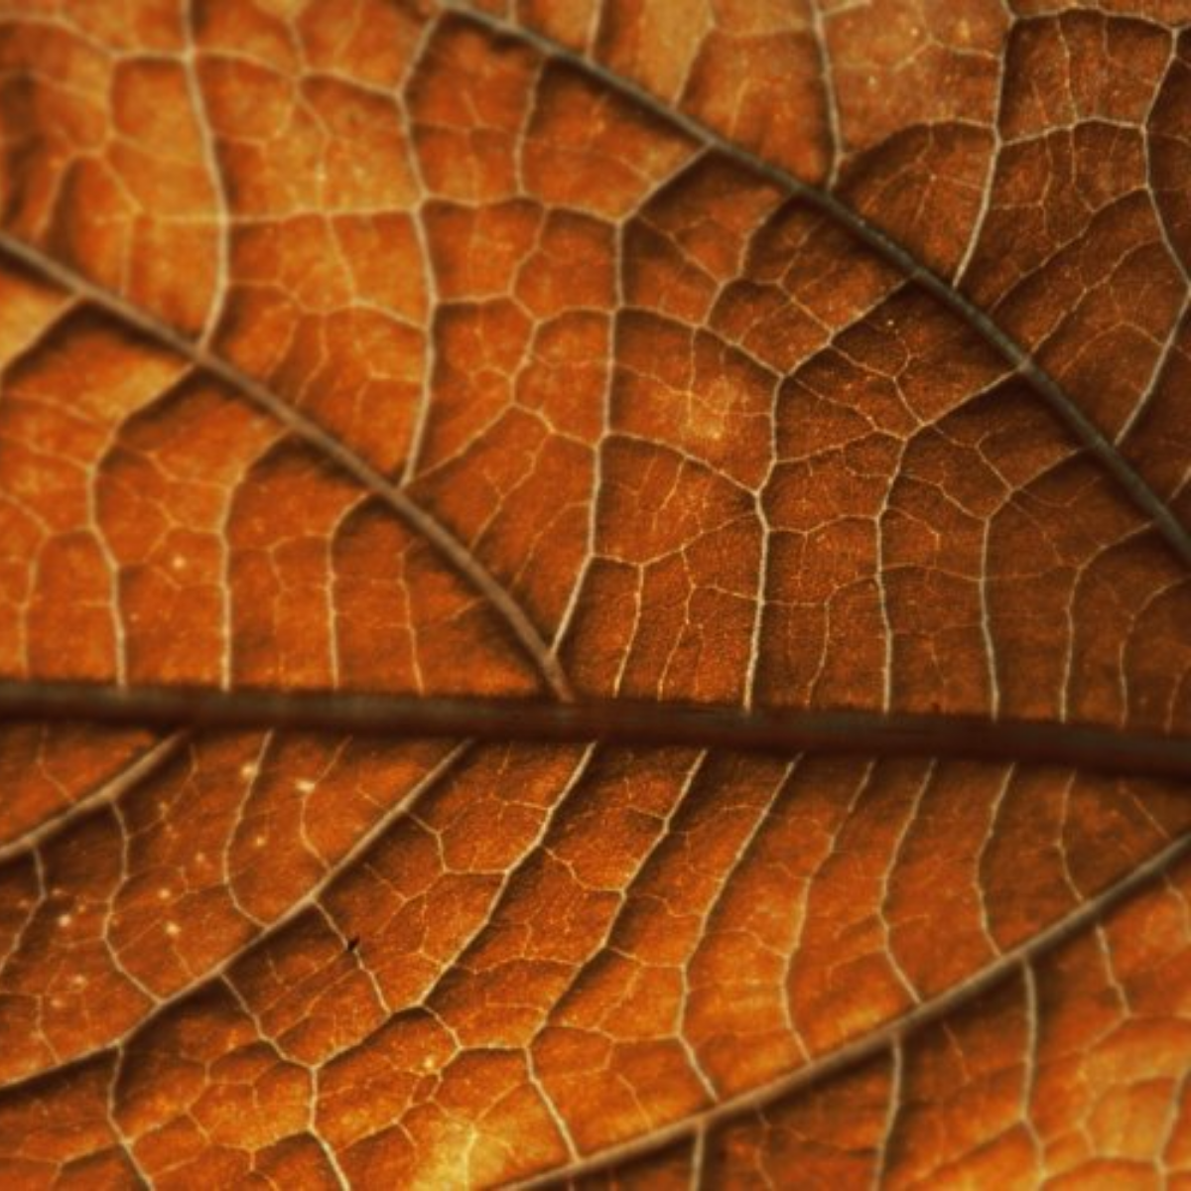
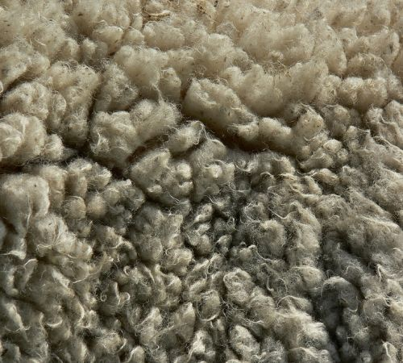
Texture
The appearance of the surface, how something FEELS
Frottage is the technique or process of taking a rubbing from an object or surface to make a work of art. It is created by placing a piece of paper on a surface and then rubbing the paper with something that makes marks, most commonly pencil or wax crayon.
Exercise 1: Create a rubbing in the box above.
Exercise 2: Draw the textures above using pen or pencil.
Exercise 3: Write over the photos with descriptive words that represent that texture.

Slide 3
EXTENSION TASK:
CAN YOU FIND MORE RUBBINGS – OF DIFFERENT TEXTURES?
CAN YOU DO A MORE REFINED/LARGER VERSION OF YOUR MOST SUCCESSFUL TEXTURE DRAWING, FROM TASK 2 ON THE TEXTURE SLIDE? ADD YOU DESCRIPTIVE WORD ON TOP OF IT, AS LIKE TASK 3 FROM THE TEXTURE SLIDE?HOW WILL YOU USE TONE EFFECTIVELY?

