Slide 1
Practical exam – Book 5
Name -

Slide 2
Task 1 Checklist
Task 1 will take 30mins and you will need to complete the following points in this time, videos are located underneath if you are stuck on a particular point
Task | Complete
Describe Cubase
Create a new project
Change the tempo
Add Stereo Audio track
Add Mono Audio track
Create software instrument track
Set output preferences
Import Audio file
Import MIDI file
Select a pre set sound for software instrument

Slide 3
Task 1 a
List 5 technical features of your Digital Audio Workstation
Software | Hardware | Editing
1 2 3 4 5 | 1 2 3 4 5 | 1 2 3 4 5

Slide 4
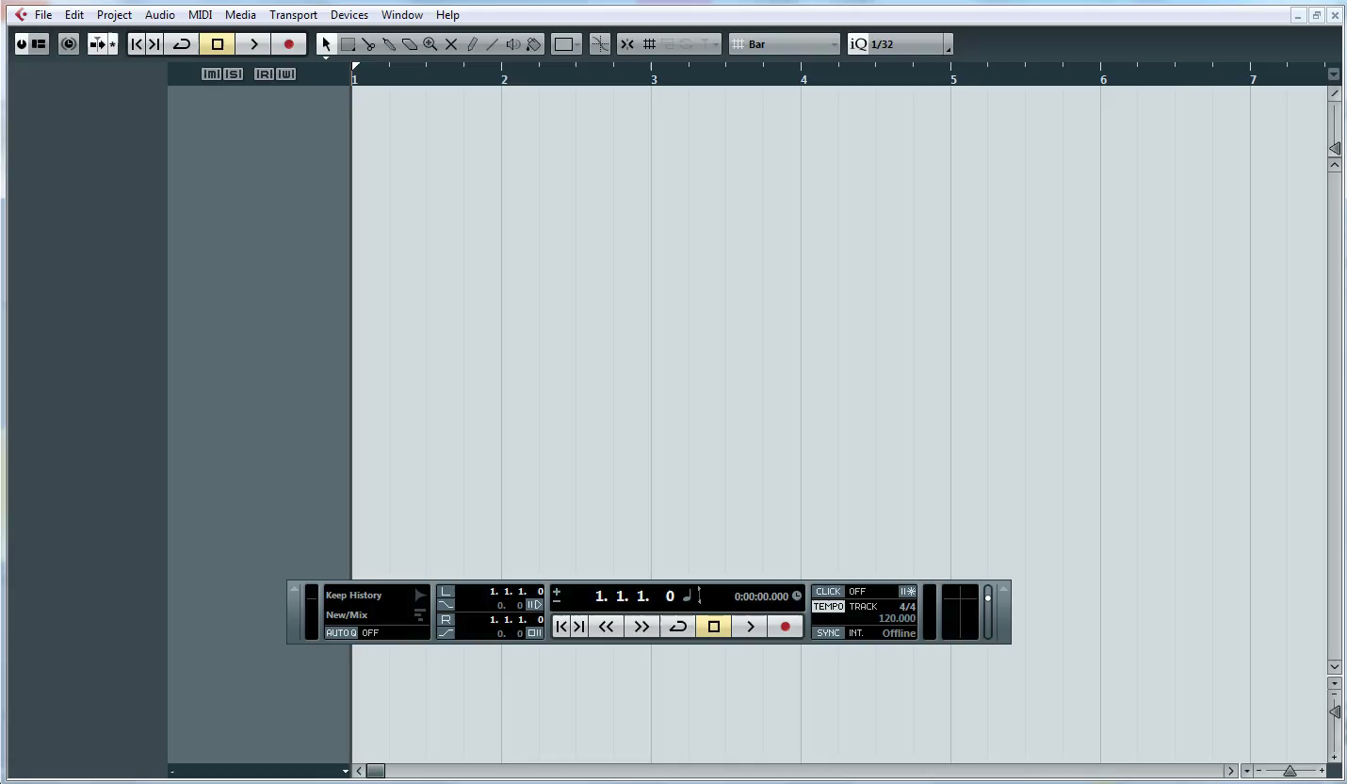
Changing Your Tempo
1 – Watch the clip below

Slide 5
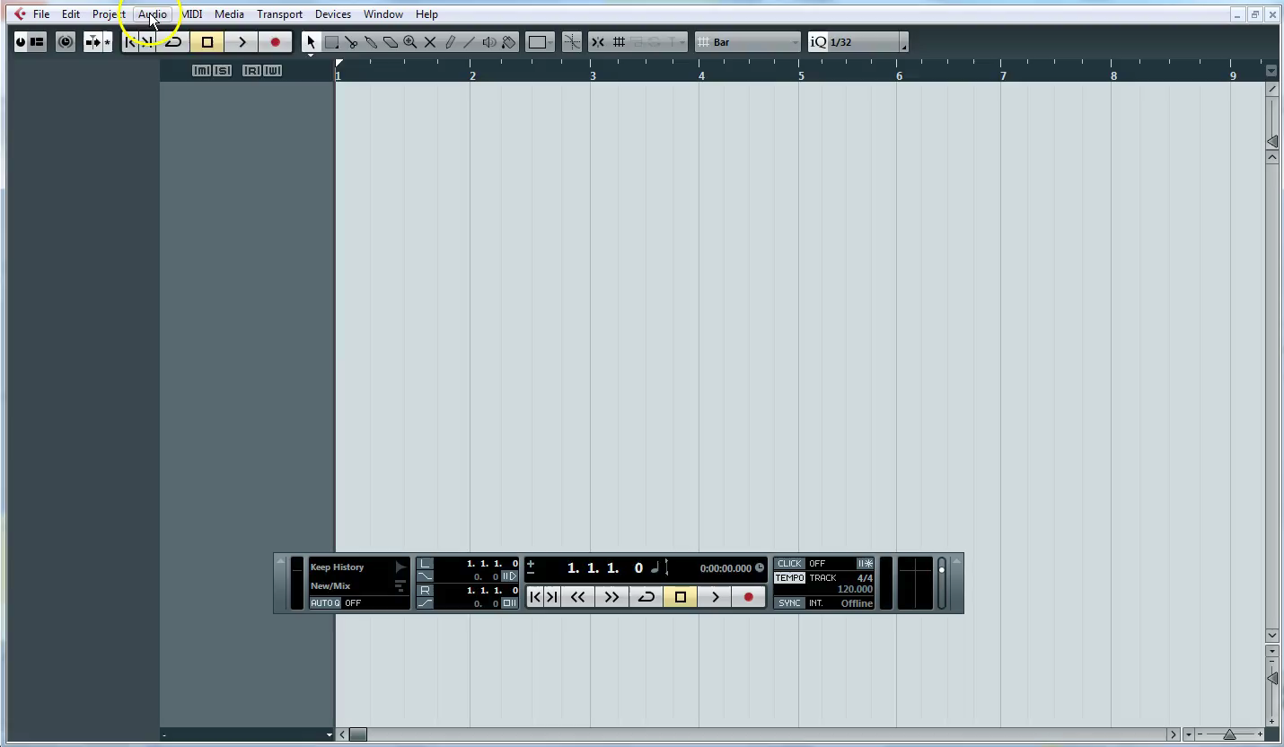
Creating Audio Tracks
1 – Watch the clip below

Slide 6
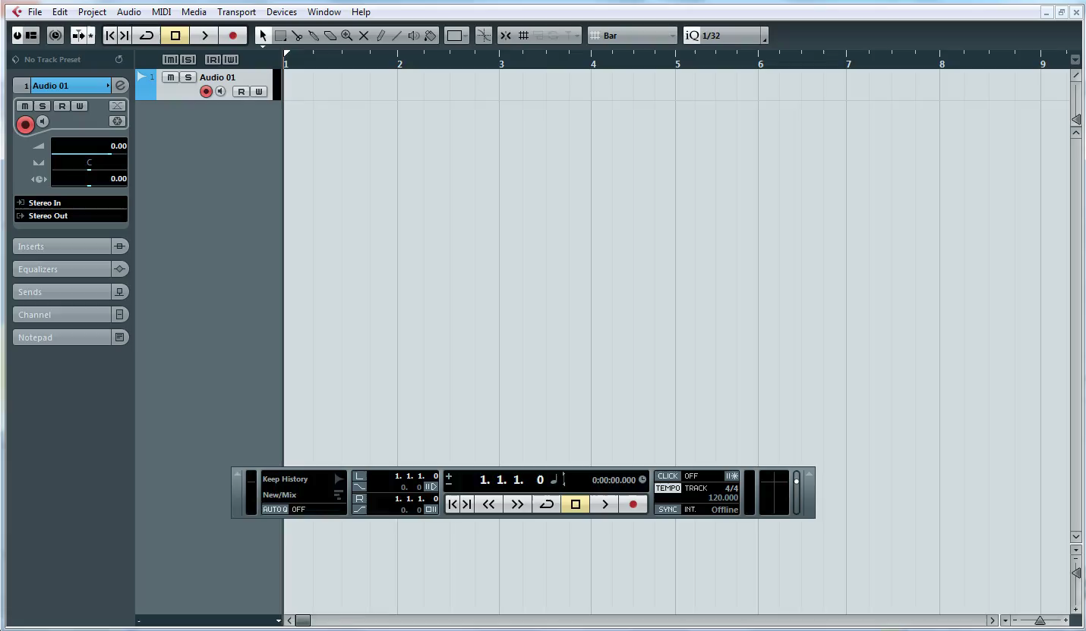
Create Software instrument tracks
1 – Watch the clip below

Slide 7
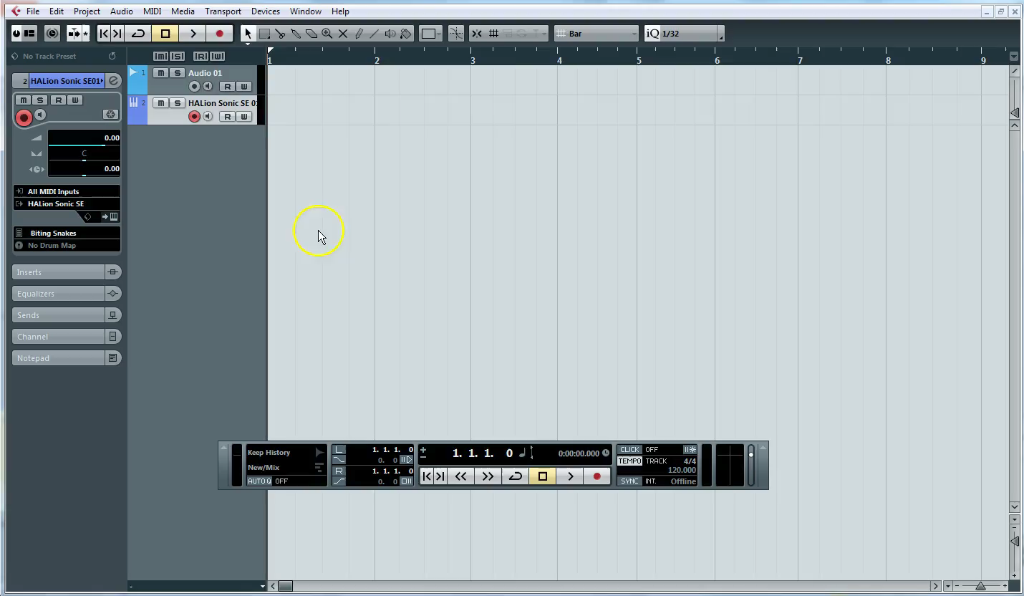
Audio Output
1 – Watch the clip below

Slide 8
Task 1 b
P
1 – Task 1 B
(p) Written explanation of your process up to this point
M
D
2 - Insert Screenshots to evidence your work

Slide 9
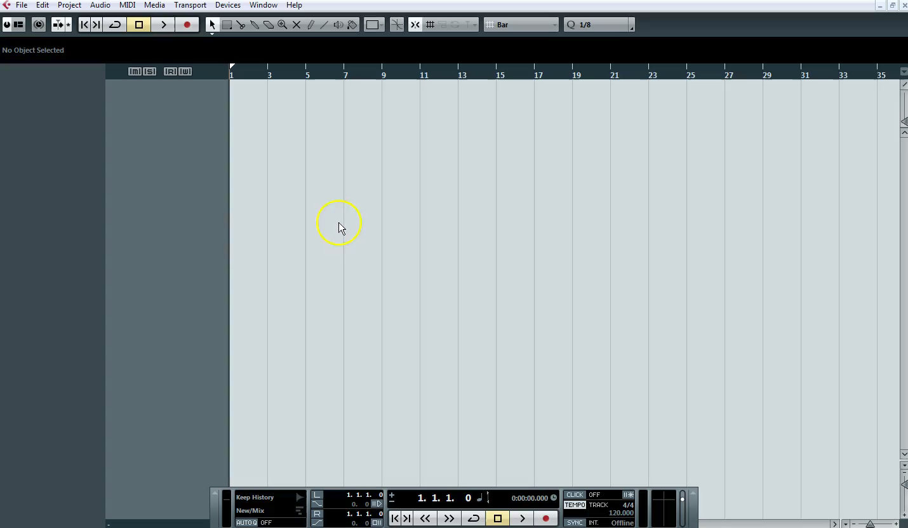
Import Audio file
1 – Watch the clip below

Slide 10
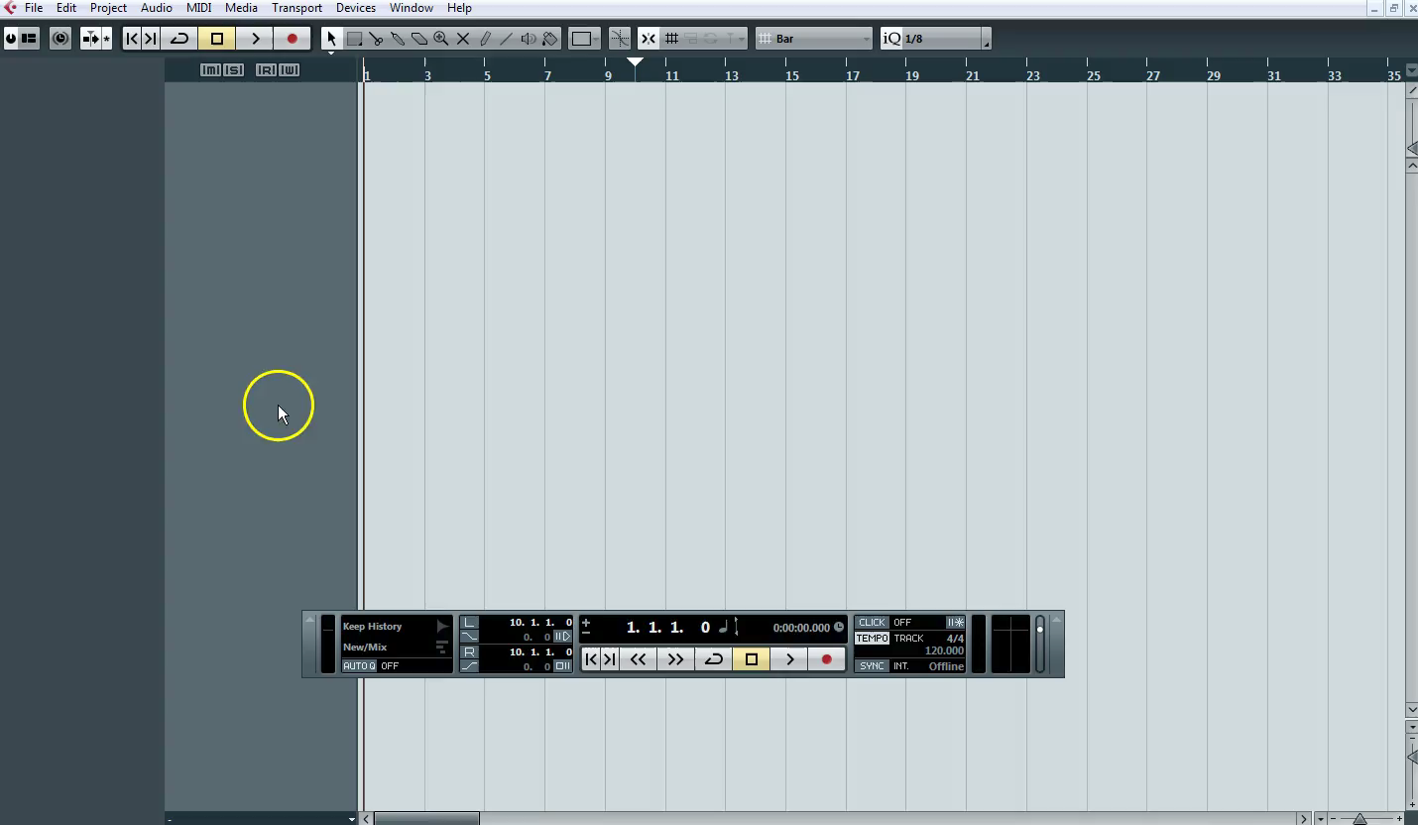
Importing MIDI
1 – Watch the clip below

Slide 11
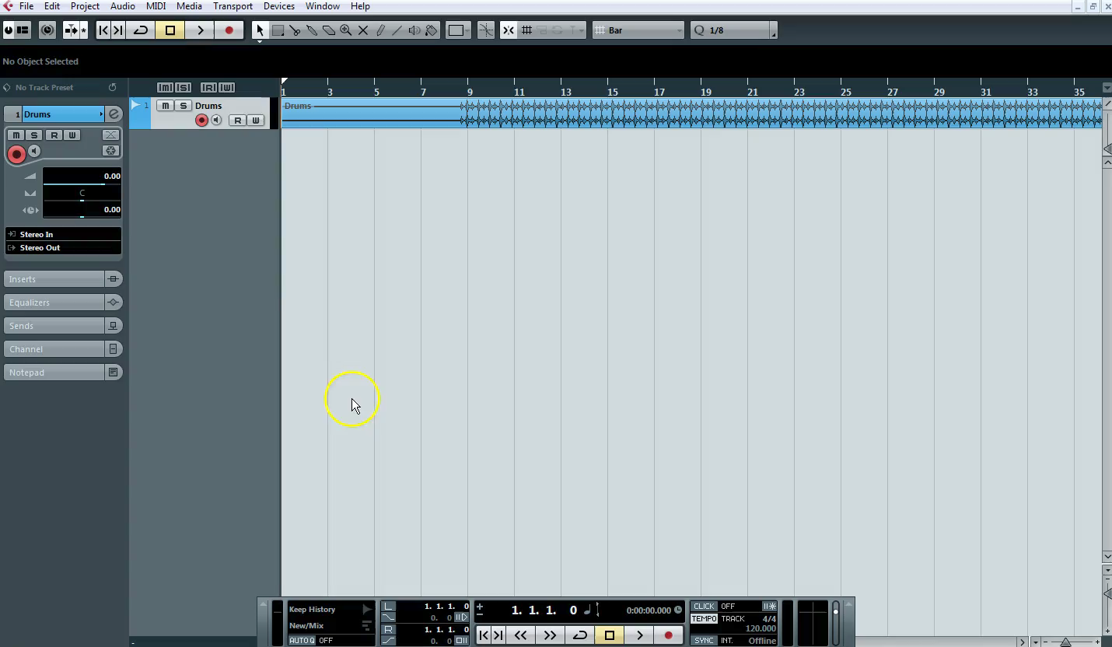
Changing a pre set sound
1 – Watch the clip below

Slide 12
Task 1 c
P
1 – Task 1 C
(p) Written explanation of your process up to this point
M
D
2 - Insert Screenshots to evidence your work

Slide 13
Music Technology
Date …. / …. / ….
Grade | Achieved?
2
3
4
5.5
7
What you did not achieve from the workbook?
Strength
Target
Grade
Teacher Comment | Pupil Response
Q1. What is tempo? | …
Q2. What audio output will you be using? | …
Q3. What is the difference between audio and MIDI tracks? | …
Response & Challenge
Presentation
☺ 😐 ☹
Effort
☺ 😐 ☹

