Slide 1
Original
Jade Englert – A*
Stage 1
Play the hook live

Slide 2
Task 1: Open Cubase

Slide 3
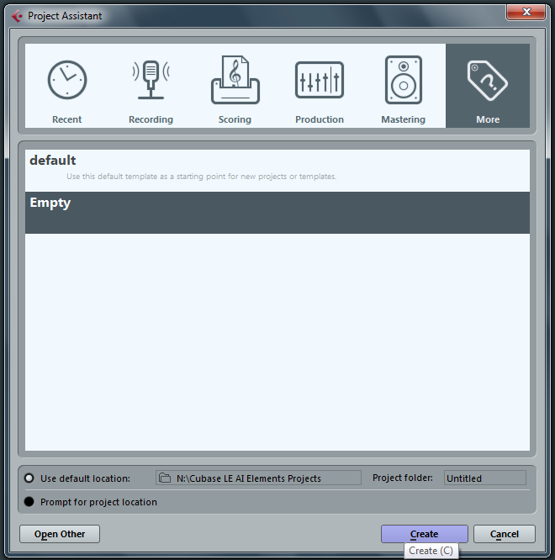
Task 2: Record the hook in real time using Cubase.
Select MORE
Select EMPTY
3. Select CREATE

Slide 4
Right mouse click here
Select ADD INSTRUMENT TRACK
3. Click here
4. Click here
5. Click here
6. Click here

Slide 5
Click here
To access instruments
Search for the sound you want by
Typing
Or
Scrolling

Slide 6
Turn the metronome on.
Press the record button, wait for the 8 bar count in, and then play the hook.
The Transport Bar
Auto quantise
To Start To End Loop Stop Play

Slide 7
PLAY THE HOOK
Key signature: The sharps F, C and G. So every time we see F, C or G we play F#, C# and G# instead.
Tempo: This tells us that the tempo is 122 beats per minute.
A
B
C#
E
F#
G#
F#
E
C#
B
A
B
C#
E
F#
G#
F#
E
C#
C is to the left - http://www.youtube.com/watch?v=zR_cwELdtHk
Virtual Keyboard - http://www.bgfl.org/bgfl/custom/resources_ftp/client_ftp/ks2/music/piano/

Slide 8
Stage 2
Punch in the bass line

Slide 9
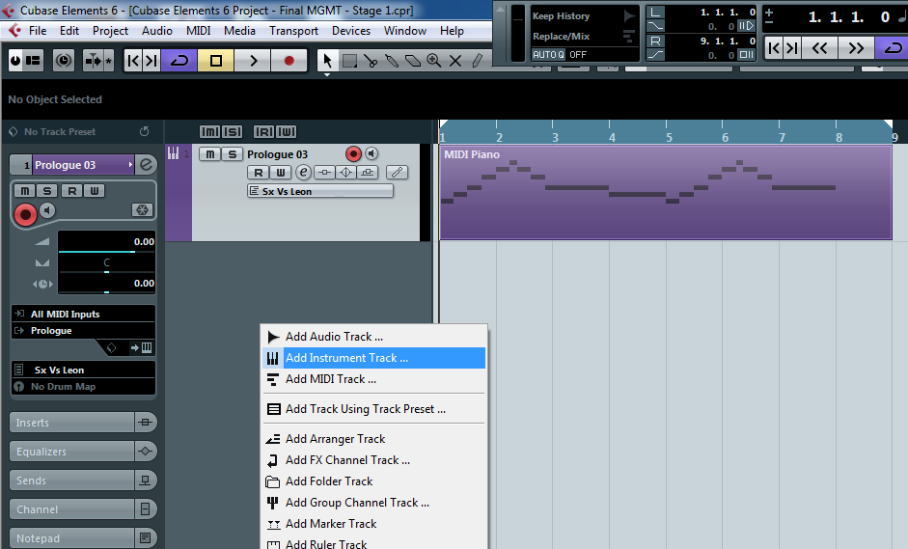
Right mouse click here
Select ADD INSTRUMENT TRACK
3. Click here
4. Click here
5. Click here
6. Click here

Slide 10
Setting up key editor in Cubase
1. Select ‘Draw’ from the tool bar
2. Draw across 4 bars in the new track
3. Select the arrow from the tool bar and then double click in the box you have just created.

Slide 11
Click here
To access instruments
Search for the sound you want by
Typing
Or
Scrolling

Slide 12
Recording your hook
Quantize:
Correct timing mistakes.
Input notes with precise timing.
Ensure ‘Snap’ is turned on.
This is the quantize box.
Select 1/8:
By selecting 1/8 your dividing each bar (numbered sections) into 8ths. So, we can now fit 8 notes in a bar. (look at music notation poster).
Don’t forget - End of Lesson process:
Save In your ‘My Documents’, ‘Music’ folder
Close Cubase
Email work to your teacher
Simples!

Slide 13
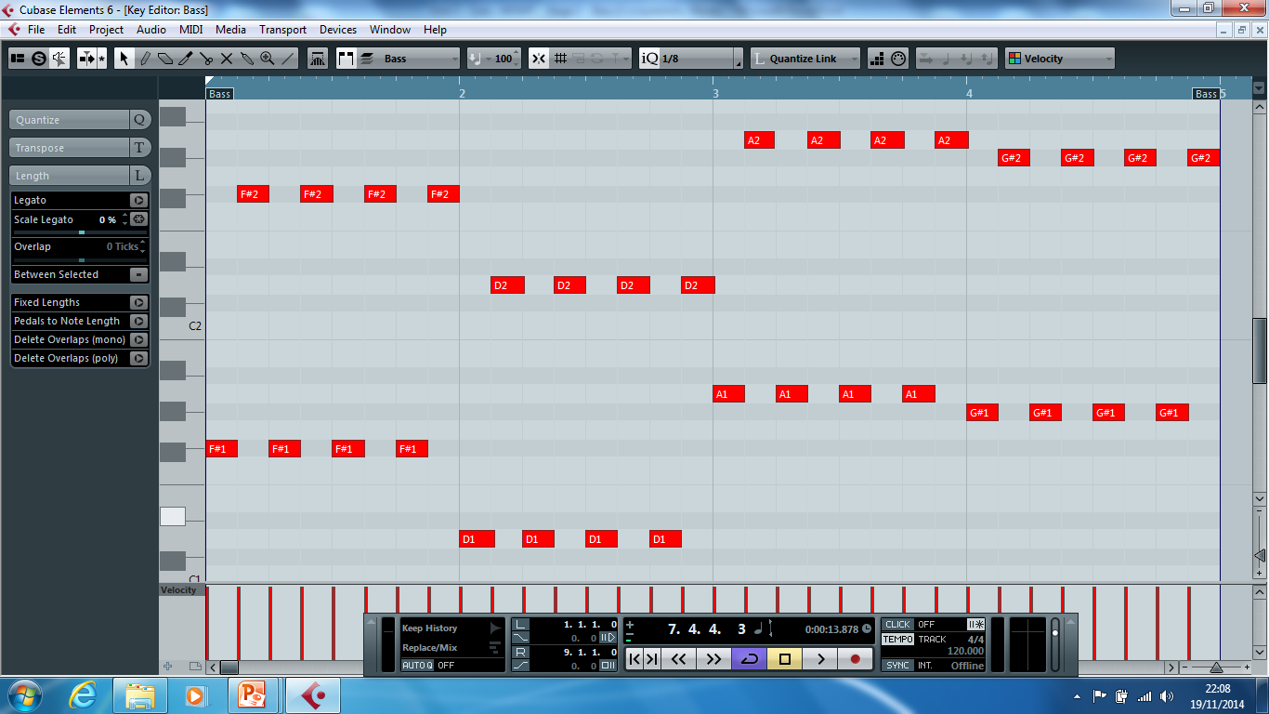
Drawing in Cubase
Select the ‘draw’ function - to draw notes into cubase. Use the piano on the left hand side as a note guide.
Use the ZOOM

Slide 14
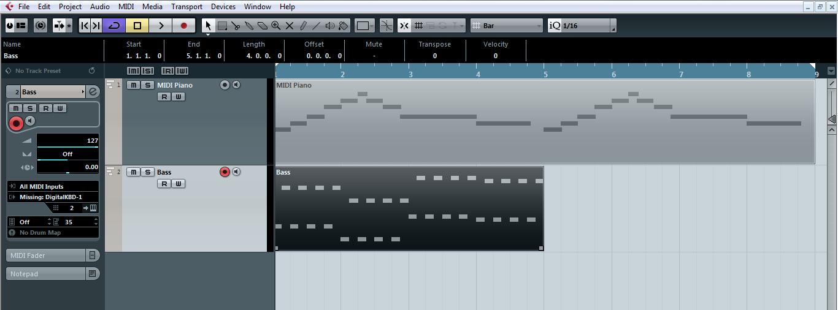
DUPLICATE THE BASSLINE – ‘ctrl + D’
Select the bass line
Touch ctrl and D

Slide 15
Stage 3
Punch in the Drum beat

Slide 16
Right mouse click here
Select ADD Software TRACK

Slide 17
THIS TIME WE’RE USING HALION
CLICK HERE
SEARCH DRUMS & SELECT
SELECT GM Map

Slide 18
CLICK HERE
CLICK HERE
CHANGE TO 10
Here you can change the individual parts of the drums

Slide 19
Setting up key editor in Cubase
1. Select ‘Draw’ from the tool bar
2. Draw across 4 bars in the new track
3. Select the arrow from the tool bar and then double click in the box you have just created.

Slide 20
SEQUENCING THE DRUMS
1. Select the drumstick tool from the tool bar.
2. Ensure the quantise value is set to 1/16. Now enter the bass drum and snare parts.
CLOSE UP OF BAR 6, 7 & 8

Slide 21
Stage 4
Punch in the counter melody

Slide 22
Right mouse click here
Select ADD Instrument TRACK

Slide 23
Click here
To access instruments
Search for the sound you want by
Typing
Or
Scrolling

Slide 24
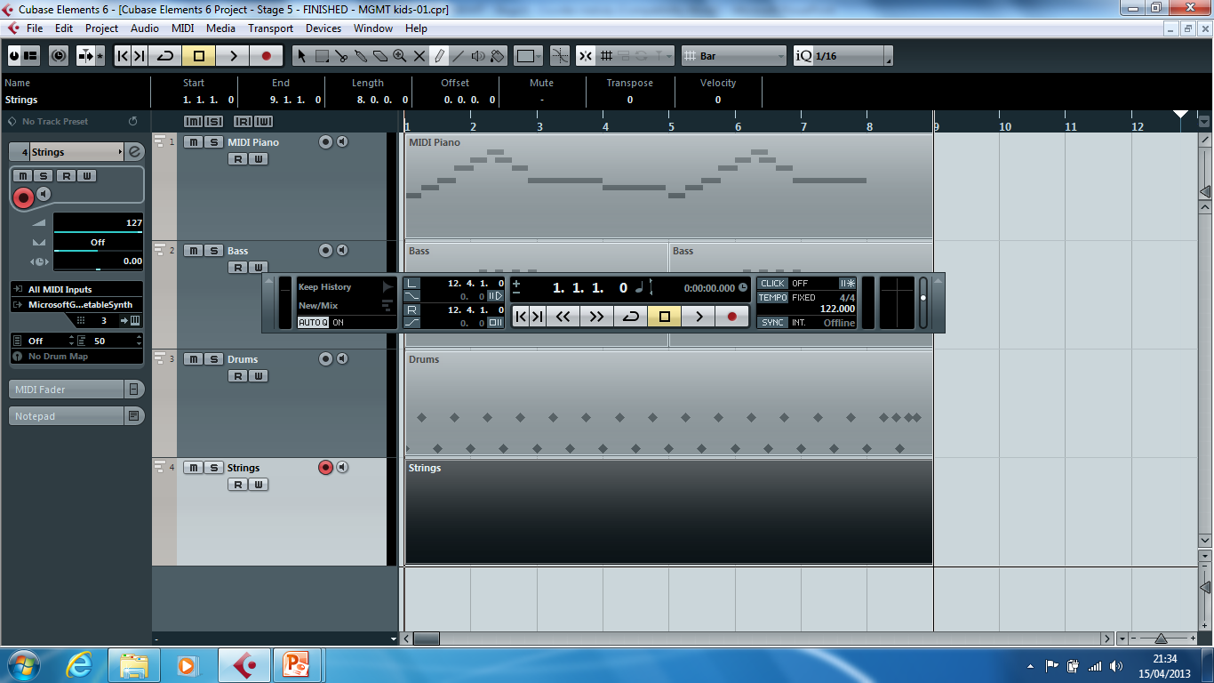
Setting up key editor in Cubase
1. Select ‘Draw’ from the tool bar
2. Draw across 8 bars in the new track
3. Select the arrow from the tool bar and then double click in the box you have just created.

Slide 25
TEACHER MUST DEMONSTRATE
Quantize:
Correct timing mistakes.
Input notes with precise timing.
Ensure ‘Snap’ is turned on.
Select the quantize box.
Select 1/8: By selecting 1/8 your dividing each bar into 16s.
1 block
2 blocks
1 2 3 4 5 6 7 8
1 2 3 4 5 6 7 8

Slide 26
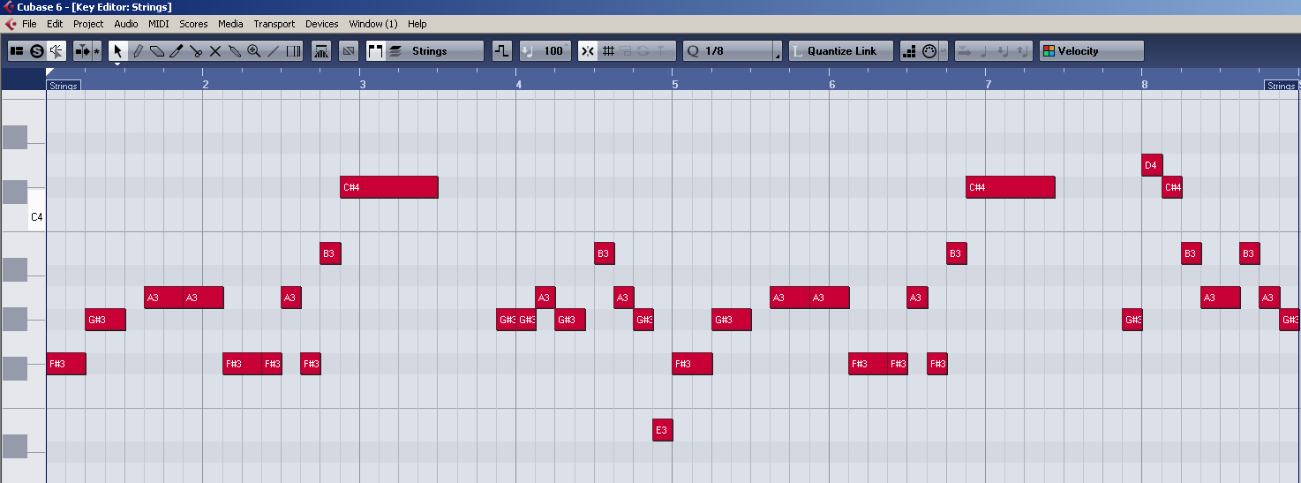
Drawing in Cubase
Select the ‘draw’ function - to draw notes into cubase.
2. Use the piano on the left hand side as a guide.
3. Select the ‘pointer’ function and you are able to lengthen and shorten notes..
4. Use the zoom function to see the notes.

Slide 27
Grade | Achieved?
NYA | Unable to open DAW
Pass | Open the DAW Add a track
Merit | Record a part on the keyboard into Cubase Draw music in Cubase
Distinction | Explain the process of recording from an instrument Explain how to create a part using the draw tool
What you did not achieve from the workbook?
Strength
Target
Grade
Teacher Comment | Pupil Response
Q1. What is a track? | …
Q2. How would you create a track? | …
Q3. Explain how Quantise may be used effectively? | …
Response & Challenge
Presentation
☺ 😐 ☹
Effort
☺ 😐 ☹

Slide 28
Stage 5
Copy & paste the structure

Slide 29
This is what your work should look like.

Slide 30
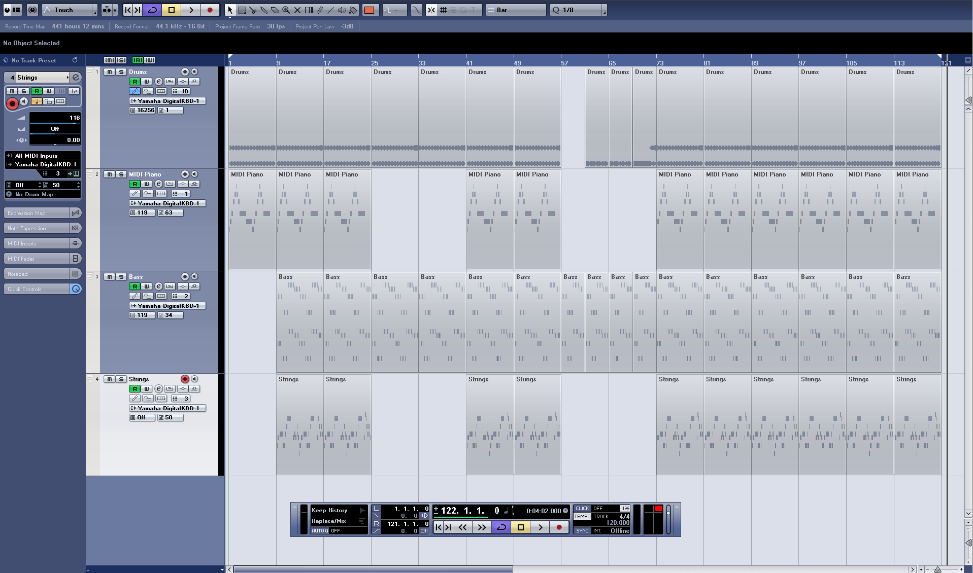
You need to duplicate (ctrl + D) your sections to look exactly the same as the image below.

Slide 31
At bar 57 the drums change. You will need to edit the drums between bar 57 and 73.

Slide 32
Select Stage 6 – Samples
Shared area – Vcert – MGMT Vocal
You must have a minimum of;
1 – Verse
1 – Chorus
1 – Middle 8
You can use as many as you like of each
Stage 6
Adding voices – NO CUBASE

Slide 33
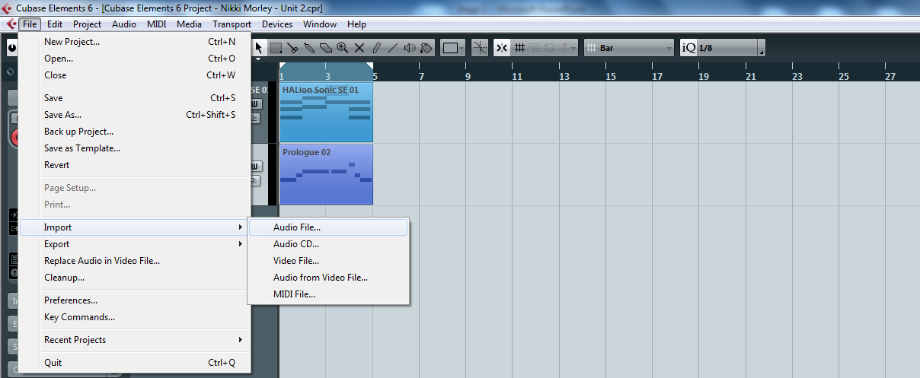
IMPORTING Audio
Click File Import Audio file
Copy to working directory so the audio is saved and assigned to the project
Click OK

Slide 34
Vocal Tracks automatically in time
Use the scissors tool to cut the chorus vocal and copy it 3 times from 73-121

Slide 35
Marks awarded for use of vocals and effects
Awareness of style required including use of effects where appropriate, such as reverb and delay
6 –5 Complete awareness of the stylistic requirements of the music with appropriate use of effects throughout the performance.
4 –3 For the upper mark, the required style is broadly in evidence and effects are used generally well, though with occasional miscalculations; at the lower mark, there is inconsistency in achieving the required style and sections where effects are misjudged or lacking.
2 –1 The performance of the music is basic with little or no sense of the required style. There is little or inappropriate use of effects.
0 The candidate’s work shows no evidence of the skills being assessed.
Stage 7
Adding effects

Slide 36
INSERTING EFFECTS
Select your TRACK and click INSERTS

Slide 37
Adding Templates
Select your BLACK BOX and click A TEMPLATE

Slide 38
Vocals Pitch Shift > Pitch correction Reverb Room works Drums Reverb Room works Dynamics > Compressor Bass Distortion Melody and Counter Melody Modulation
Effects to use

Slide 39
Editing sounds
Select a DIAL OR SWITCH and click and drag to move this up and down

Slide 40
Use of an appropriate dynamic range
6 –5 Excellent management of dynamics in ways completely appropriate to the music.
4 –3 Occasional miscalculations of dynamic with 3 awarded where there are sections in which the dynamic range is miscalculated and/or very limited.
2 –1 Often inappropriate choice/use of dynamics which adversely affect the impact of large sections of the recorded performance.
0 The candidate’s work shows no evidence of the skills being assessed.
Stage 8
Adding dynamics

Slide 41
Press F3 to bring up the Mixer and adjust the volumes with the FADERS so all instruments can be heard

Slide 42
Click here on each track to show Automation.

Slide 43
Marks awarded for use of dynamics
Use of an appropriate dynamic range
6 –5 Excellent management of dynamics in ways completely appropriate to the music.
4 –3 Occasional miscalculations of dynamic with 3 awarded where there are sections in which the dynamic range is miscalculated and/or very limited.
2 –1 Often inappropriate choice/use of dynamics which adversely affect the impact of large sections of the recorded performance.
0 The candidate’s work shows no evidence of the skills being assessed.
1. Select the Line tool
2. Draw in the space below the MIDI data to create changes in volume with the line tool
3. No shark teeth!

Slide 44
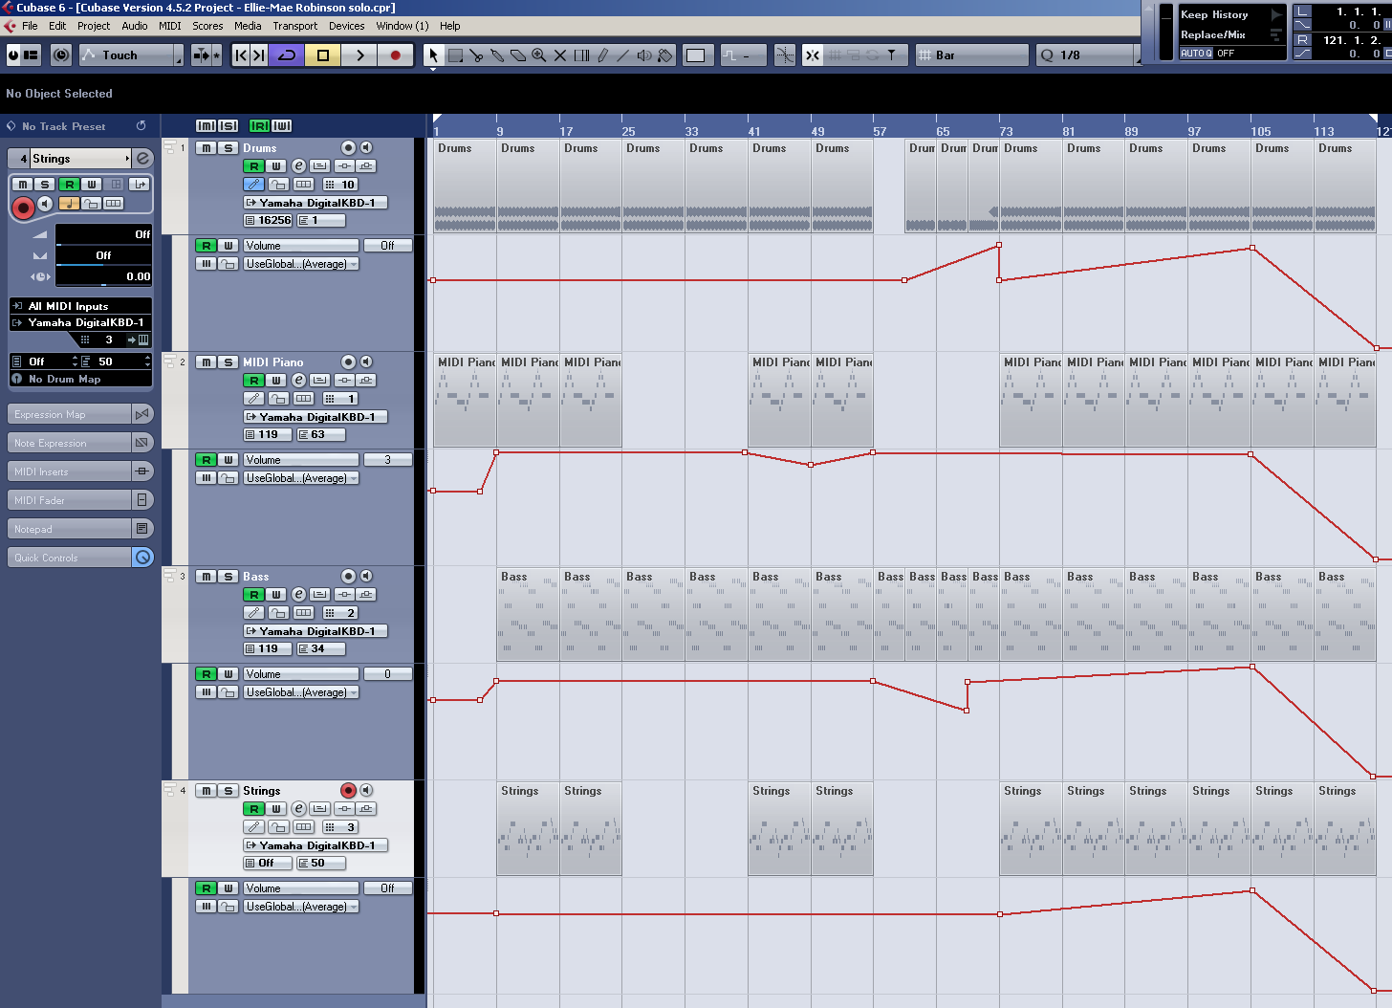
Ideas… Crescendo and all sorts

Slide 45
Marks awarded for use of panning
Use of panning to obtain a clear recording and, where necessary, to separate sounds that utilise similar frequency ranges
6 –5 Judicious use of panning to gain a clear and effective recording.
4 –3 Some evidence of use of panning though, for the lower mark, the panning is less clear and less effective.
2 –1 Little or no evidence of the use of panning to obtain a clear recording.
0 The candidate’s work shows no evidence of the skills being assessed.
Stage 9
Panning

Slide 46
Press F3 to bring up the Mixer and adjust the panning with the Blue Bar so all instruments are in a different place

Slide 47
Click here on each track to show Automation.

Slide 48
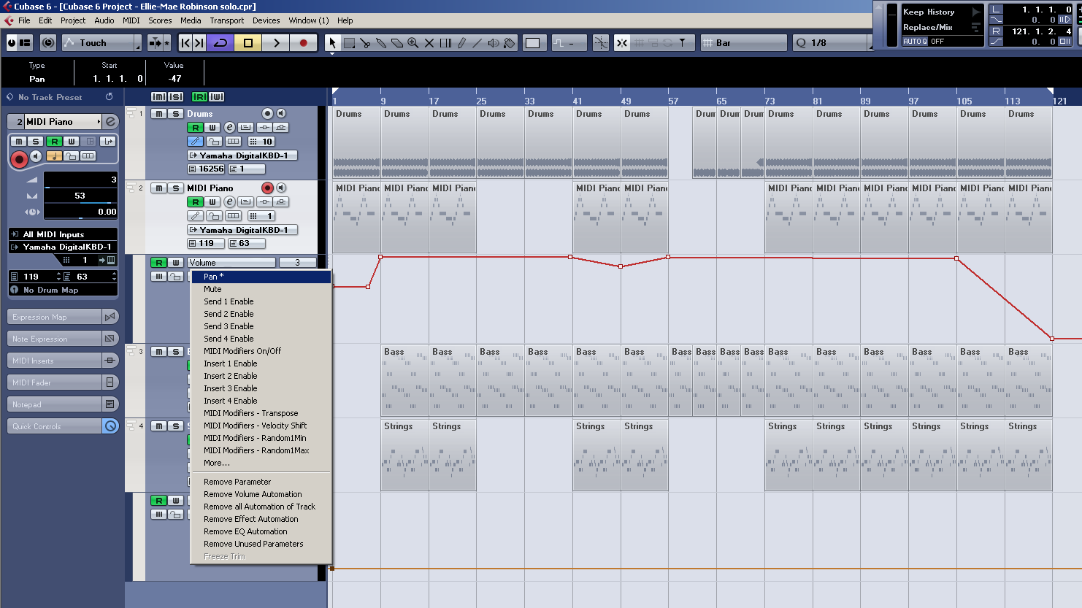
Click on volume and select Pan from the drop down menu.

Slide 49
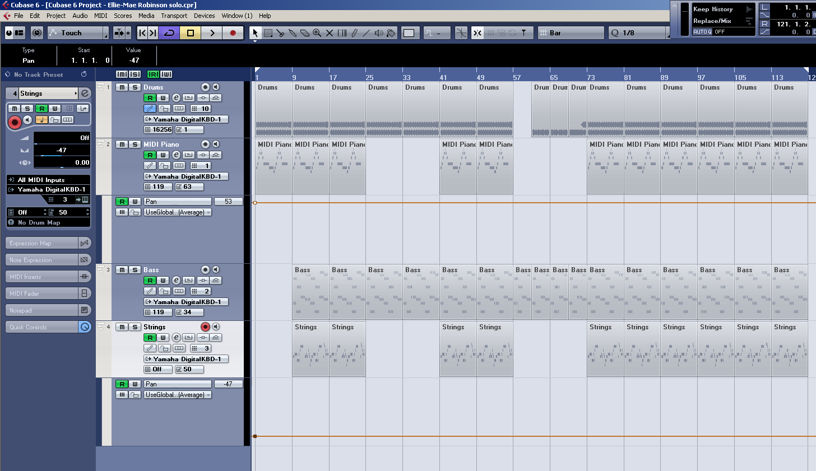
Panning works the same way inserting dynamics does. So select your line tool and draw in your panning between bars 57 and 73

Slide 50
Grade | Achieved?
NYA | Unable to open DAW
Pass | Import Vocals Draw Bassline Draw Drums
Merit | Record a part on the keyboard Draw in String counter melody Duplicate samples for structure
Distinction | Add 3 or more Effects Use automation to change volumes Use automation to add panning
What you did not achieve from the workbook?
Strength
Target
Grade
Teacher Comment | Pupil Response
Q1. What is panning? | …
Q2. Name 3 types of effect | …
Q3. Explain how automation improves your piece | …
Response & Challenge
Presentation
☺ 😐 ☹
Effort
☺ 😐 ☹

