Slide 1
Practical exam – Book 8
Name -

Slide 2
Task 4 Checklist
Task 4 will take 30mins and you will need to complete the following points in this time, videos are located underneath if you are stuck on a particular point
Task | Complete
4A – Use automation to change volumes and panning
4B – Add Effects to your piece
4C – Final mix – Volumes, Panning, Effects
4D - Export audio

Slide 3
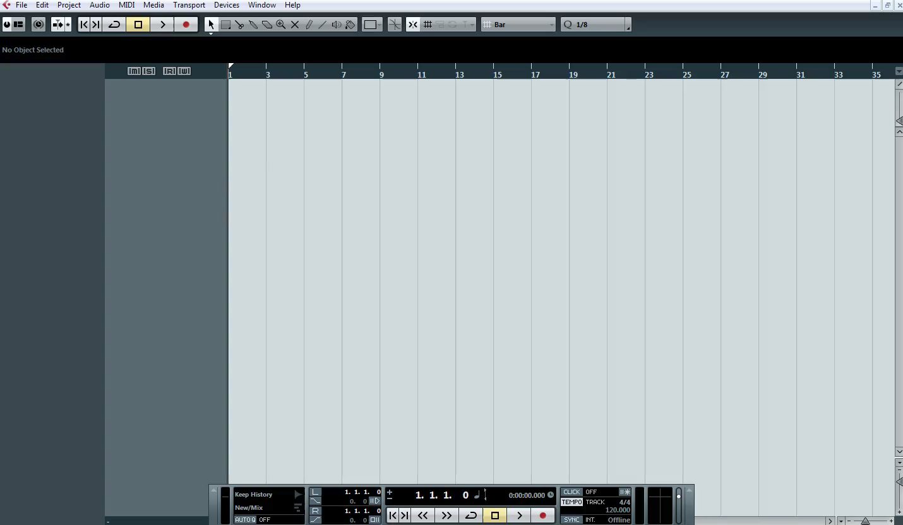
Automation - Create a fade in
1 – Watch the clip below

Slide 4
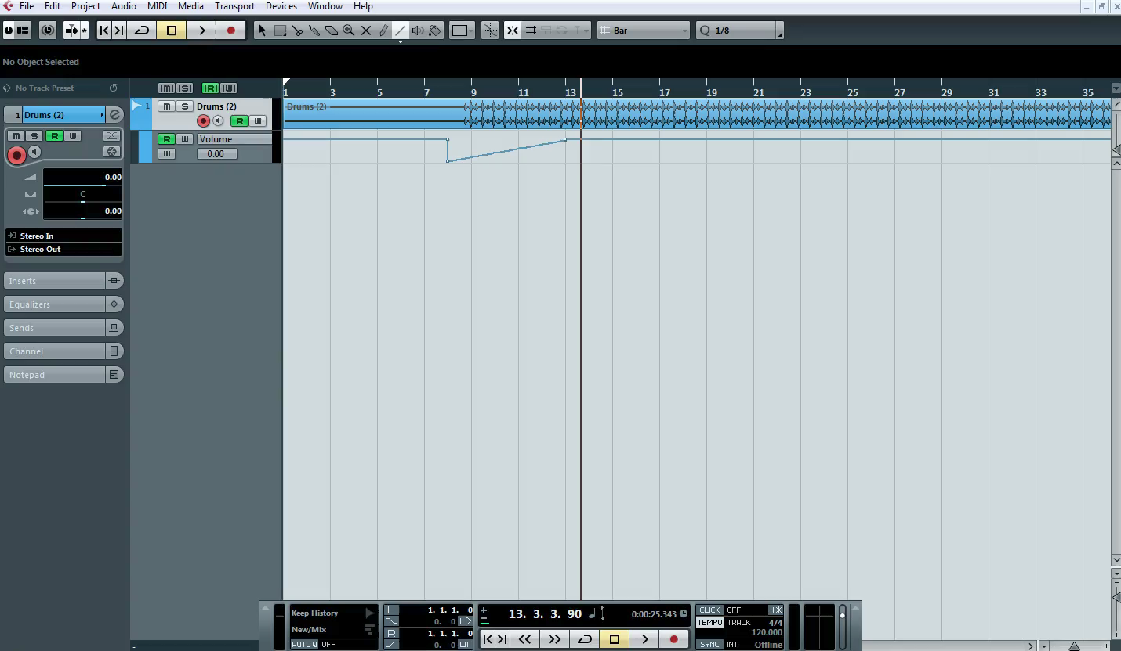
Automation - Panning
1 – Watch the clip below

Slide 5
4a
P
4a
(p) Written explanation of your process up to this point
M
D
2 - Insert Screenshots to evidence your work

Slide 6

Effects
1 – Watch the clip below

Slide 7
4B
P
4b
(p) Written explanation of your process up to this point
M
D
2 - Insert Screenshots to evidence your work

Slide 8
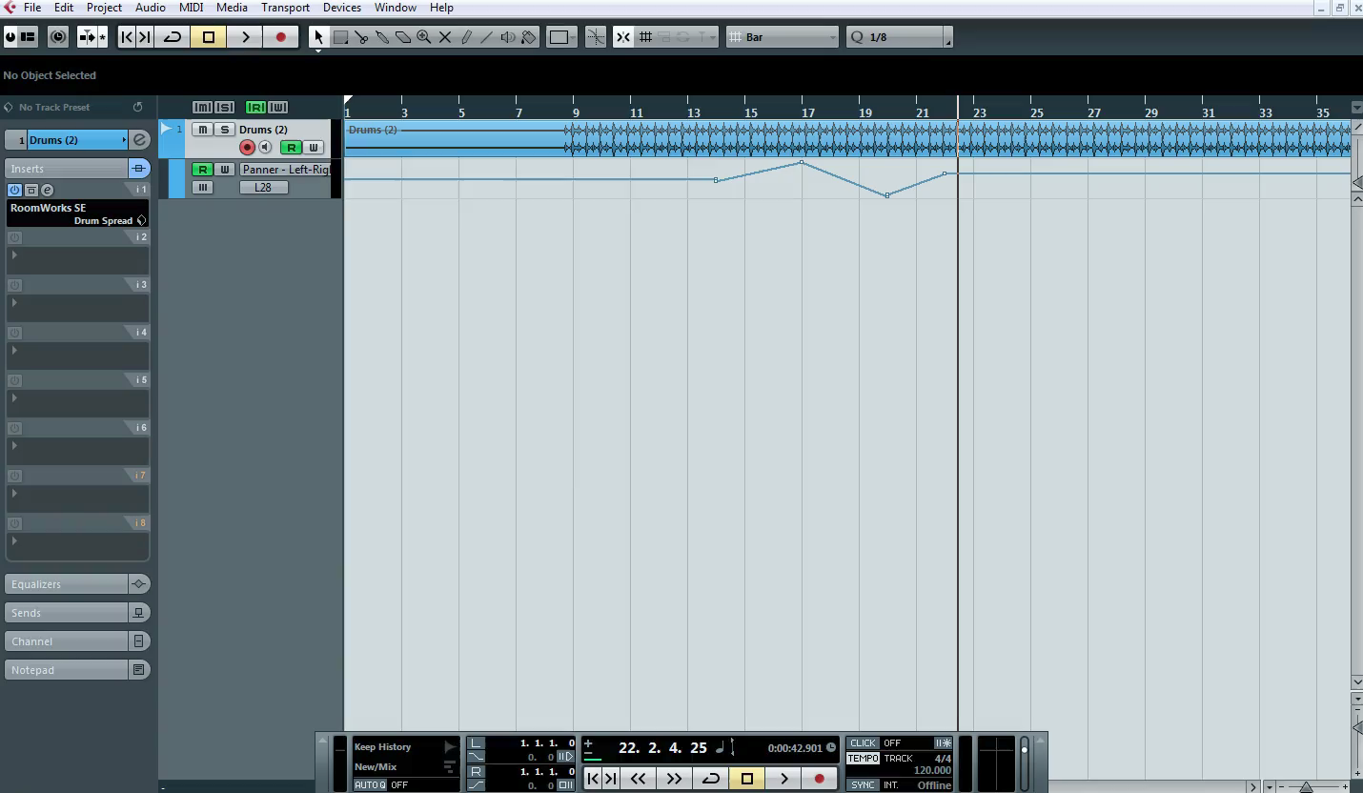
Final Mix
1 – Watch the clip below

Slide 9
4c
P
4c
(p) Written explanation of your process up to this point
M
D
2 - Insert Screenshots to evidence your work

Slide 10
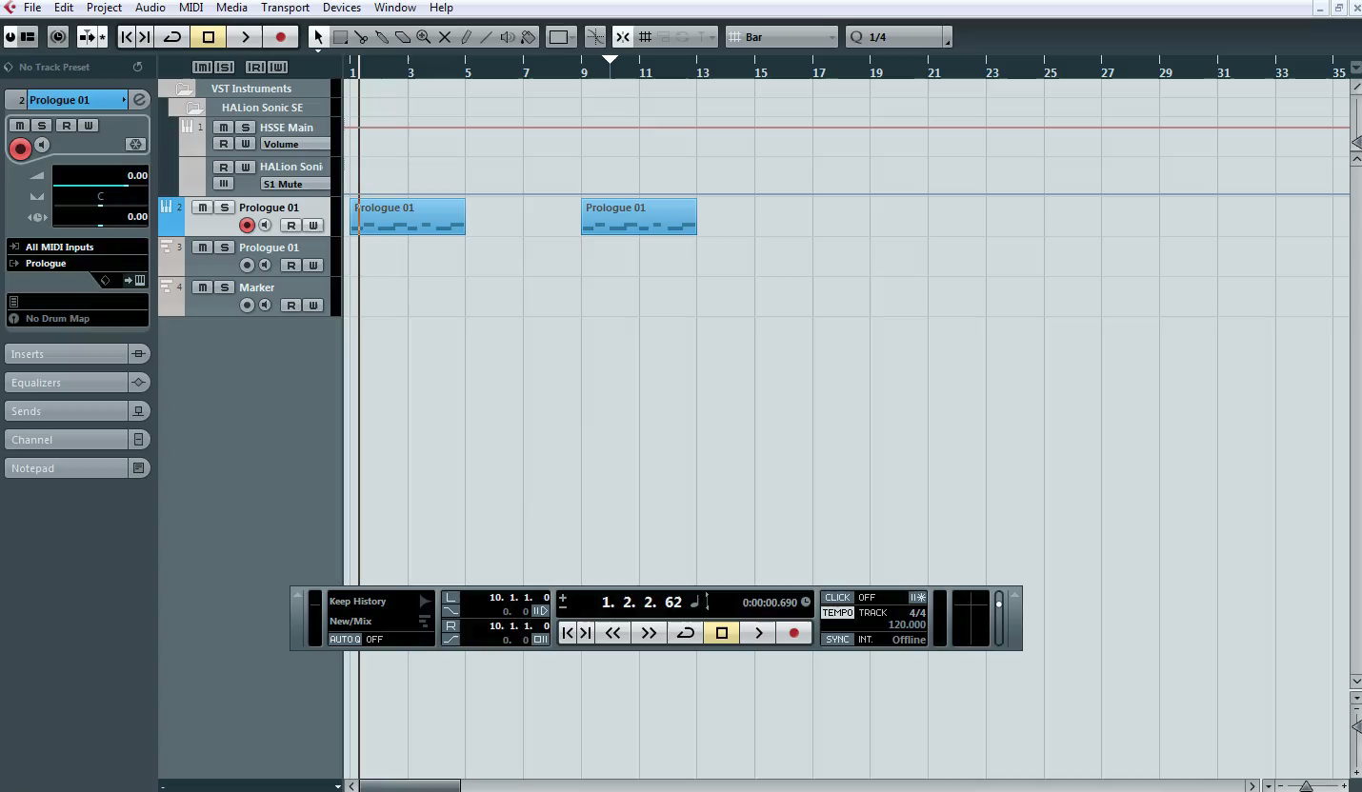
Exporting the song
1 – Watch the clip below

Slide 11
4d
P
4d
(p) Written explanation of your process up to this point
M
D
2 - Insert Screenshots to evidence your work

Slide 12
Music Technology
Date …. / …. / ….
Grade | Achieved?
NYA
Pass 4
MERIT 5.5
DIST 7
What you did not achieve from the workbook?
Strength
Target
Grade
Teacher Comment | Pupil Response
Q1. Explain ‘Setting the poles’ when exporting in Cubase | …
Q2. What is Quantise? | …
Q3. Duplicate is what? | …
Response & Challenge
Presentation
☺ 😐 ☹
Effort
☺ 😐 ☹

